Slide 1


Lunar ROADSTER
(Robotic Operator for Autonomous Development of Surface Trails and Exploration Routes)
“Starting with a foothold on the Moon, we pave the way to the cosmos”
Notes:
Greet, Full form

Slide 2
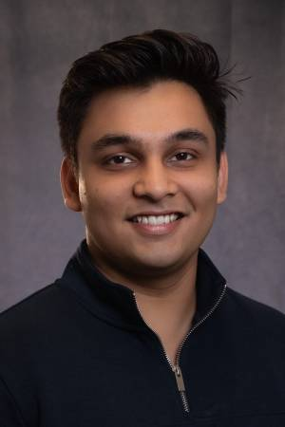

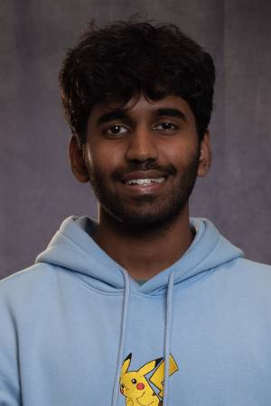
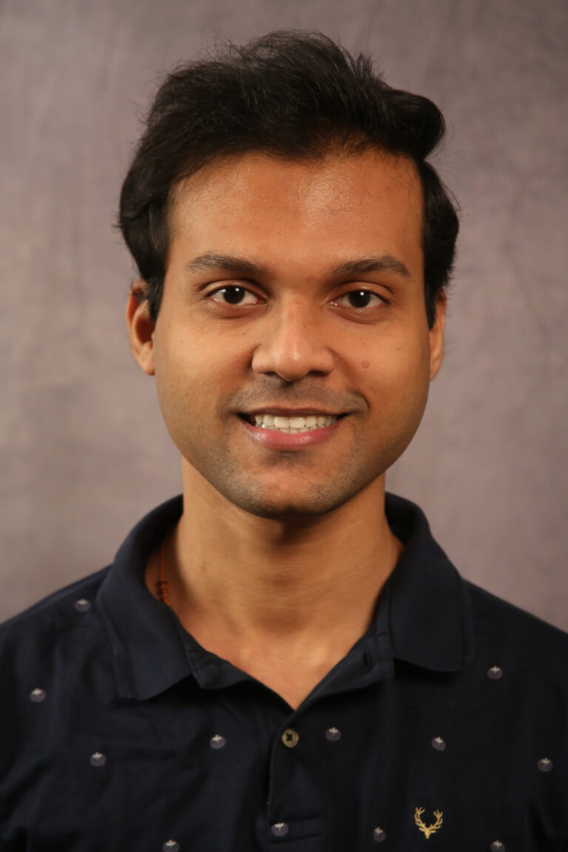


The Team
Ankit Aggarwal
Deepam Ameria
Bhaswanth Ayapilla
Simson D’Souza
Boxiang (William) Fu
Dr. William “Red” Whittaker
Notes:
-Introduce team

Slide 3
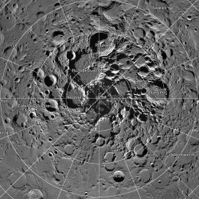
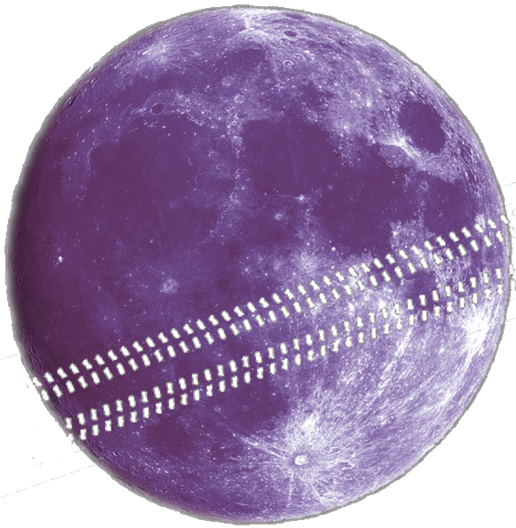
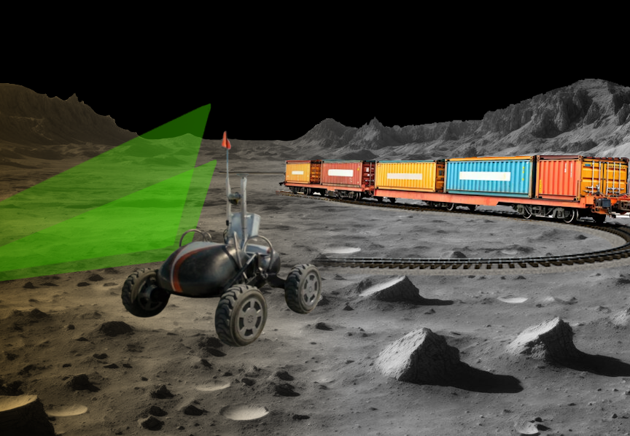
Motivation: The Lunar Polar Highway
CIRCUMNAV
Is it possible for a solar-powered rover to repeatedly drive around the Moon and never encounter a sunset?
Notes:
Humanity is returning to the Moon, particularly the south pole, as a long-term outpost.
For sustainable exploration, we need reliable infrastructure—starting with a traversable route.

Slide 4
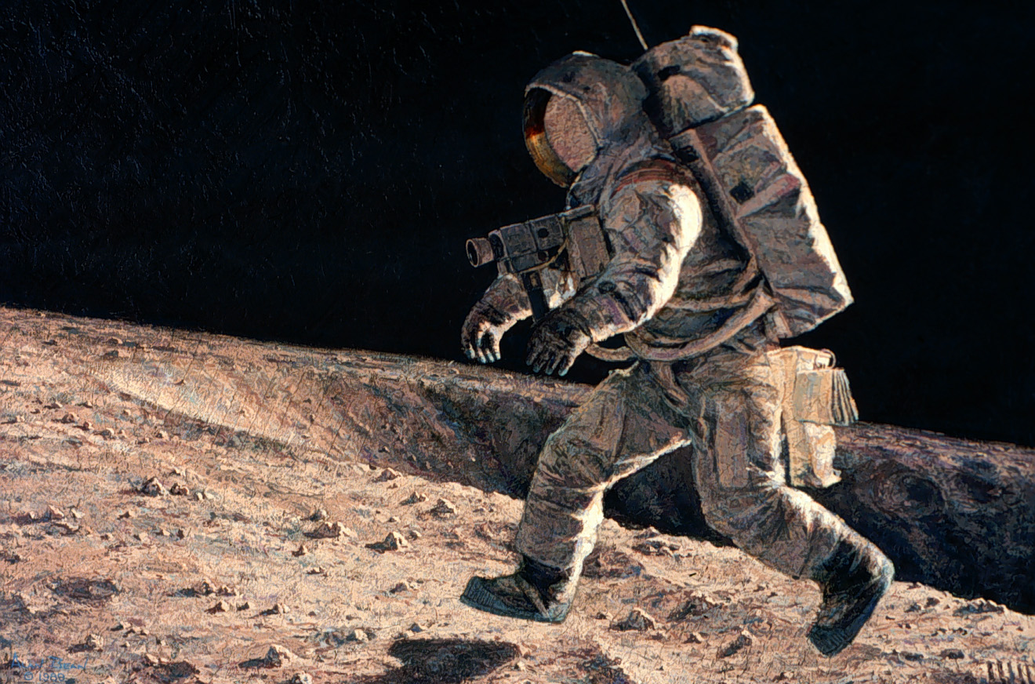
Motivation: The Lunar Polar Highway
Sun-synchronous circumnavigation around Moon at 28 days x 24 hr = 672 hour sun rotation
Jogging speed if the route was flat, circular and traversable
At equator 11,000 km 16 kph
At 50 deg 7,040 km 10 kph
At 60 deg 5,500 km 8 kph
At 70 deg 3,700 km 6 kph
At 75 deg 2,800 km 4 kph
At 80 deg 1,870 km 3 kph
At 81 deg 1,529 km 2.5 kph
Notes:
Turns out, at 75° latitude, a rover can achieve sun-synchronous circumnavigation around the pole at just 4 km/h(that’s literally just walking jogging speed).
But this assumes a flat, nearly circular path—something that doesn’t exist naturally. That’s where our project comes in.

Slide 5
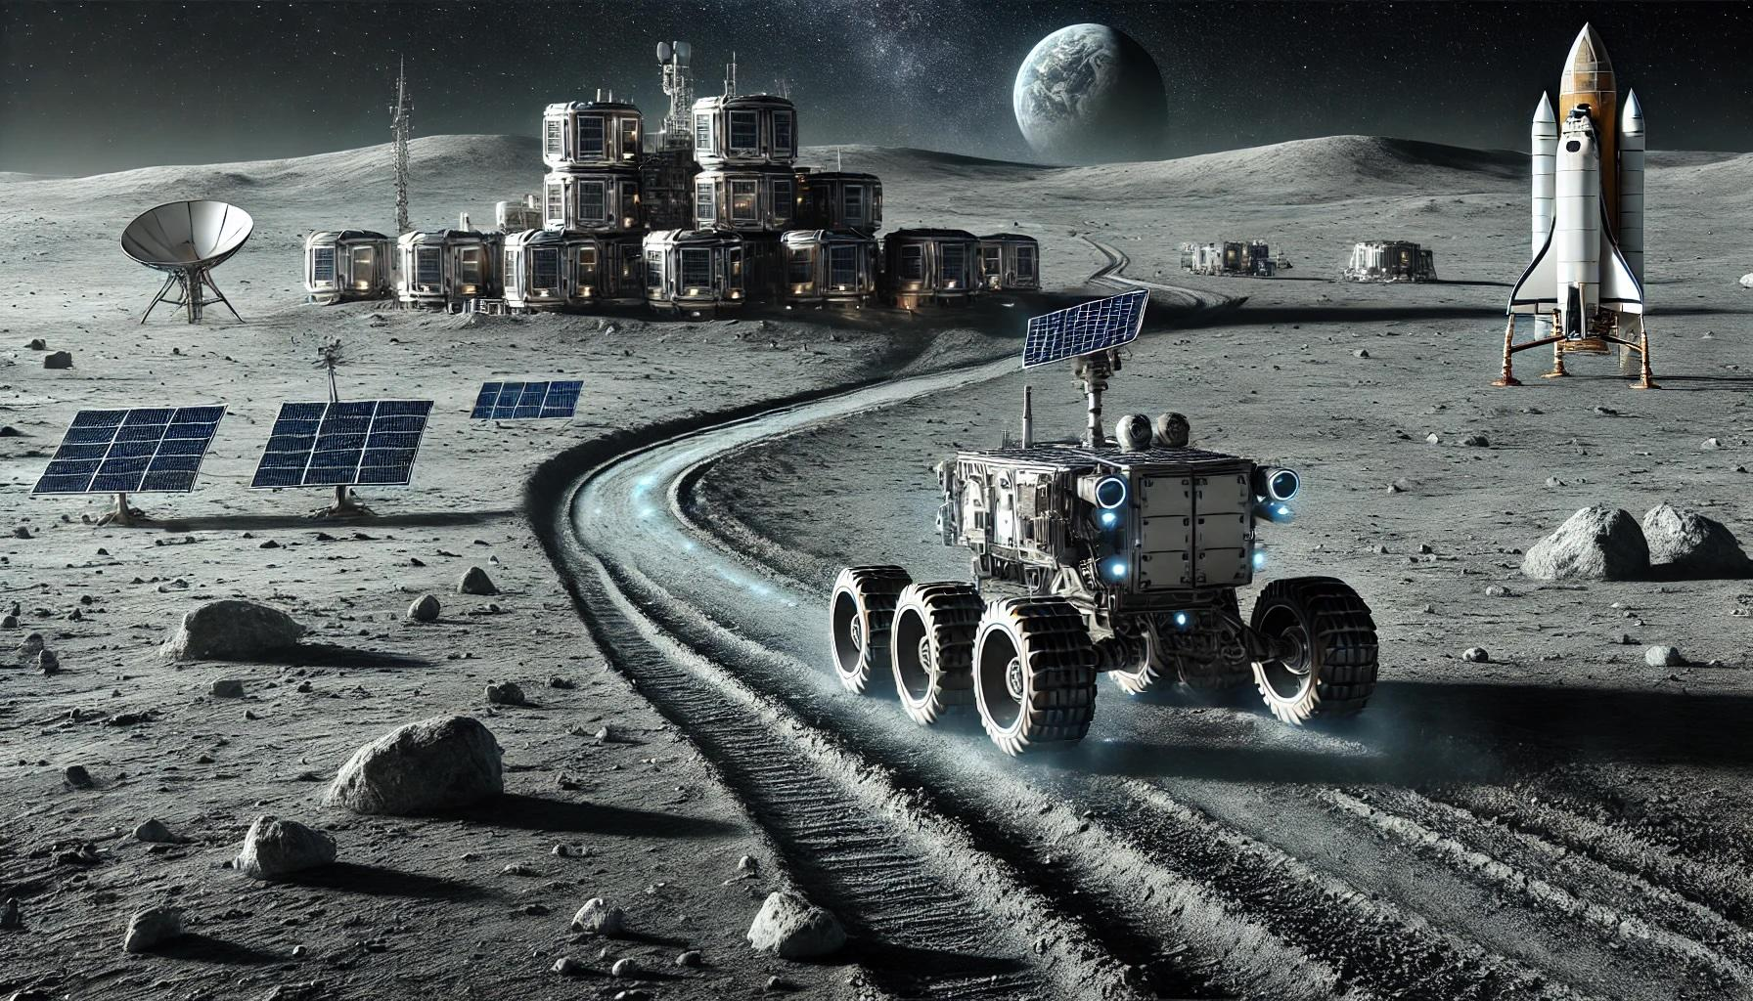
The Project: Lunar ROADSTER
An autonomous moon-working rover capable of finding ideal exploration routes and creating traversable surface trails.
By grooming trail paths, rovers with less traversing capabilities will be able to travel at higher speeds and higher power efficiencies.
A traversable and circuitous trail path will allow rovers to maintain sun-synchronicity, thereby allowing machines to run for much longer.
The groomed trails will become the backbone for colonization of the Moon by enabling transportation, logistics and enterprise development.
Notes:
Lunar ROADSTER
Autonomous Moon-working rover, capable of finding optimal exploration routes and creating traversable surface trails (30)

Slide 6
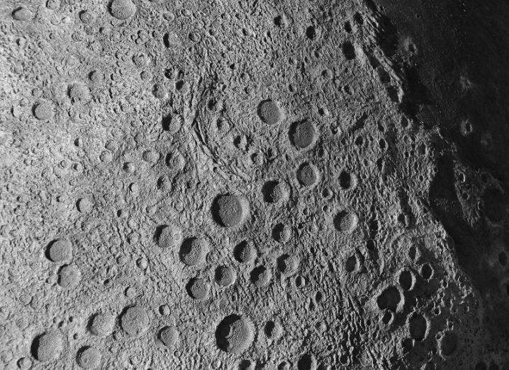
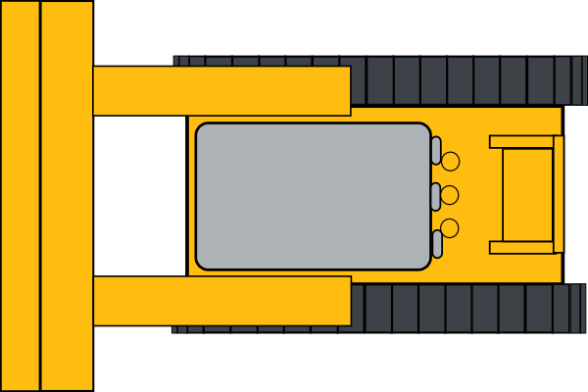
Use Case: Circular Path Grooming
Lunar ROADSTER
Reference Latitude
Groomed Path
Crater to Avoid
Original Traversable Path
Craters to Groom
Notes:
This is our primary use case. The dotted line represents a chosen latitude, the blue path represents the original, rough, circuitous path
The green lines represent the groomed path that makes the original path much safer, direct and energy-efficient for solar powered rovers.
The rover will create this path while grooming certain craters in its path, while avoiding big/deep craters

Slide 7
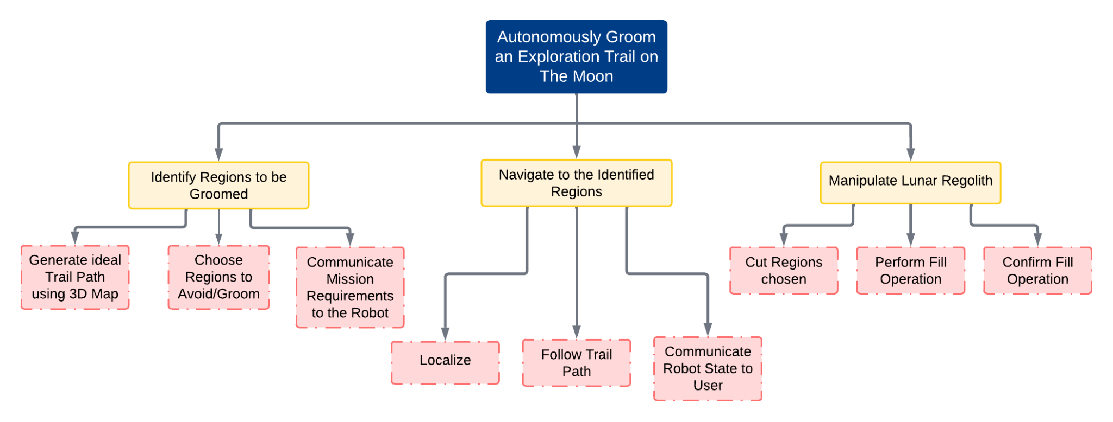
Objectives Tree
Notes:
Our work is structured into three main objectives, each with specific sub-objectives, ensuring a methodical approach
My colleagues will now dig deeper on these objectives. Over to you Simson.

Slide 8
Functional Requirements (Mandatory)
Sr. No. | Mandatory Functional Requirement
M.F.1 | Shall perform trail path planning
M.F.2 | Shall operate autonomously
M.F.3 | Shall localize itself in a GPS denied environment
M.F.4 | Shall navigate the planned path
M.F.5 | Shall traverse uneven terrain
M.F.6 | Shall choose craters to groom and avoid
M.F.7 | Shall grade craters and level dunes
M.F.8 | Shall validate grading and trail path
M.F.9 | Shall communicate with the user
Notes:
FR1 - off board on the moon station (laptops)
FR2, FR3, FR4 - Mission requirements communicated, robot localizes, navigates autonomously
FR5 - Physical capability
FR6, FR7 - Path planning -> Tool planning - manipulation
FR8 - Validation -> sensor suite
FR9 - Communication infrastructure

Slide 9
Non-Functional Requirements (Mandatory)
Sr. No. | Parameter | Description
M.N.1 | Weight | The rover must weigh under 50kg
M.N.2 | Cost | The cost for the project must be under $5000
M.N.3 | Computing Capacity | The onboard computer should be able to run all required tasks
M.N.4 | Size/Form Factor | The rover should measure less than 1m in all dimensions
Notes:
NFM1 - Align with the performance requirements
NFM2 - MRSD Project Budget
NFM3- Onboard computing - Localization, Tool Planning, Navigation, Validation
NFM4 - Moon Pit, 5x5, NFM1

Slide 10
Non-Functional Requirements (Desirable)
Sr. No. | Parameter | Description
D.N.1 | Technological Extensibility | The system will be well documented and designed so that future teams can easily access and build on the work
D.N.2 | Aesthetics | Requirement from sponsor, the rover must look presentable and lunar-ready
D.N.3 | Modularity | To enable tool interchangeability, the tool assemblies must be modular and easy to assemble/disassemble
D.N.4 | Repeatability | The system will complete multiple missions without the need of maintenance
Notes:
NFD1 - Well structured and documented for future
NFD2 - Unique sponsor requirement
NFD3 - Want our robot to be modular, have easily changeable manipulators/tools, adjustable to similar other missions
NFD4 - Want it to be able to perform the missions multiple times, thus improving robustness

Slide 11
Performance Requirements (Mandatory)
Sr. No. | Performance Metrics
M.P.1 | Will plan a path with cumulative deviation of <= 25% from chosen latitude’s length
M.P.2 | Will follow planned path to a maximum deviation of 10%
M.P.3 | Will climb gradients up to 15° and have a contact pressure of less than 1.5 kPa
M.P.4 | Will avoid craters >= 0.5 metres and avoid slopes >= 15°
M.P.5 | Will fill craters of up to 0.5 meters in diameter and 0.1m in depth
M.P.6 | Will groom the trail to have a maximum traversal slope of 5°

Slide 12
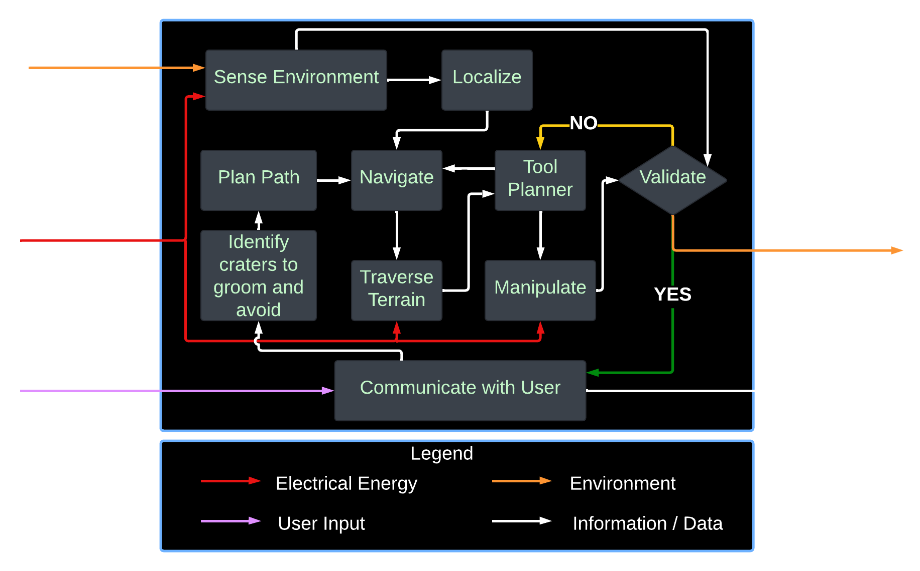
Functional Architecture

Slide 13
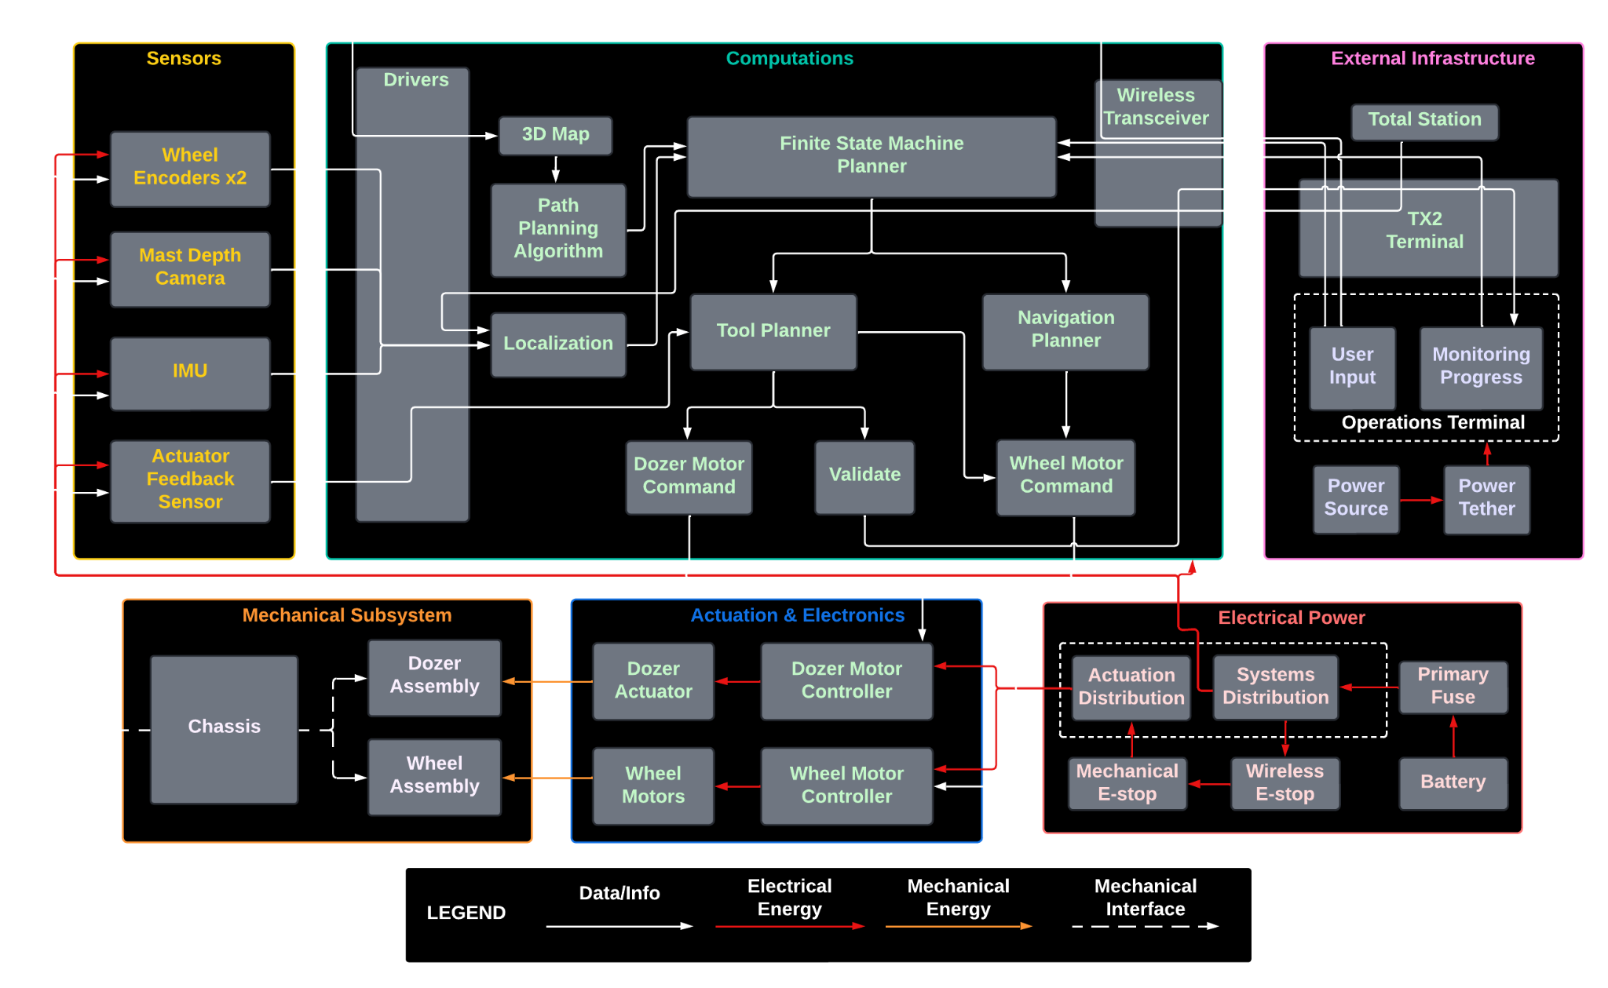
Cyber-Physical Architecture

Slide 14
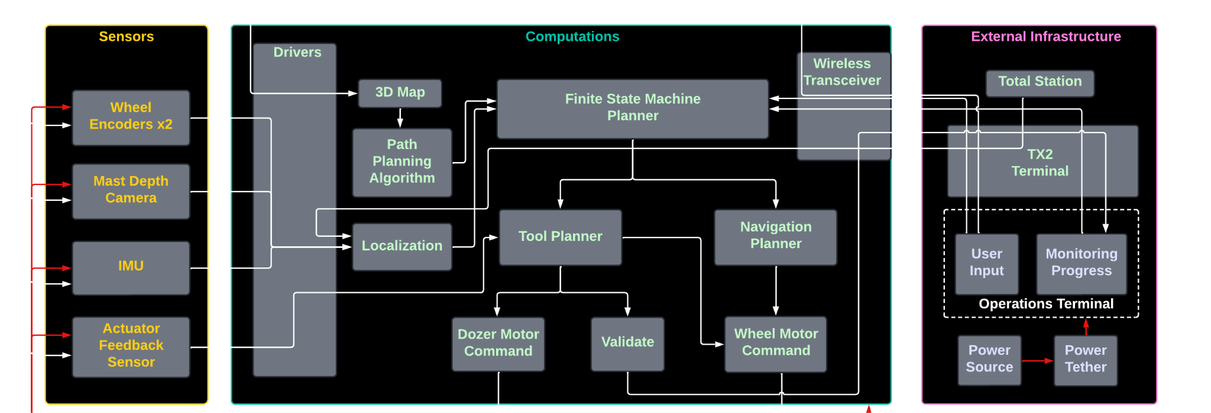
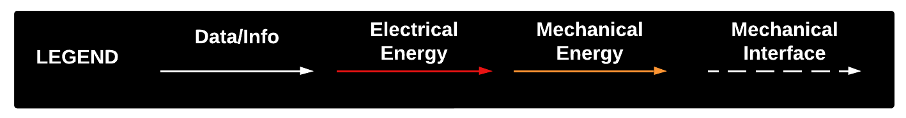
Cyber-Physical Architecture

Slide 15
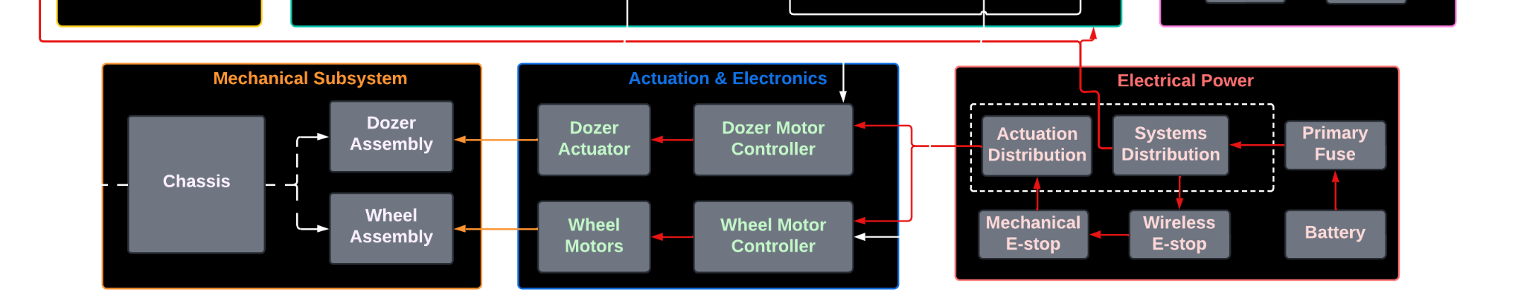
Cyber-Physical Architecture

Slide 16
Subsystem Completion Status
Subsystem | Completion % | Future Work
Sensors | 50% | Interface ZED and actuator drivers with docker
Computations | 50%
1. Jetson and Docker | 95% | Integrate ZED drivers
2. Localization Unit | 75% | Tuning of EKF parameters
3. Tool Planner Unit | 10% | Implement unit
4. Navigation Planner Unit | 30% | Setup Nav Stack, Integrate Localization and Nav Unit
External Infrastructure | 100% | None
Mechanical | 75%
1. Dozer Assembly | 85% | Refinement of Dozer
2. Wheel Assembly | 65% | Wheel Design Iterations, Final Manufacturing
Actuation | 60% | Linear Actuator tuning, Wheel encoder tuning
Electrical Power | 50% | Manufacturing and Integrating Electronic Box and PDB

Slide 17
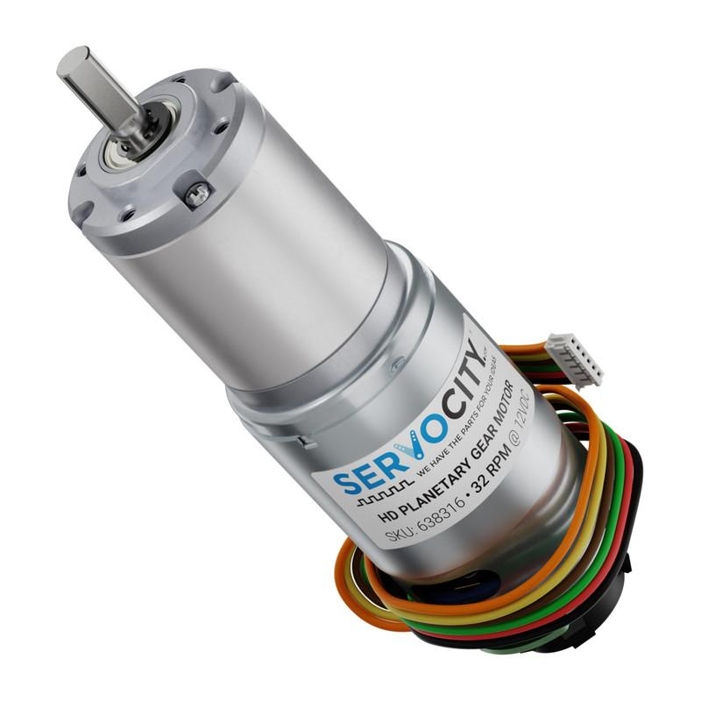
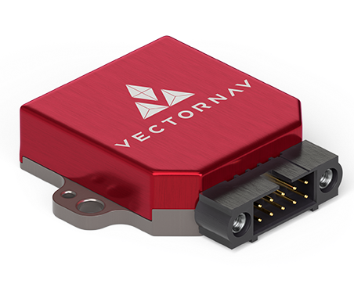
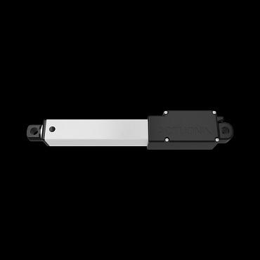
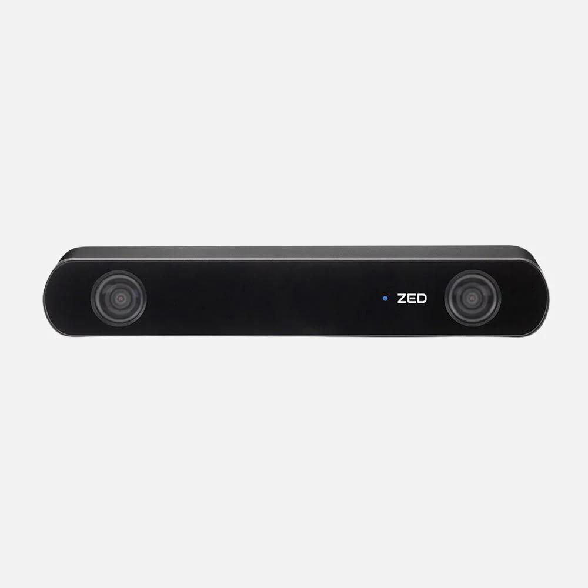
Description: Sensors Subsystem
Description: All sensors used on the rover for computations.
Requirements:
Wheel Encoders (x4)
Mast Depth Camera (ZED 2i Stereo Camera)
IMU (VectorNav)
Actuator Feedback Sensor
Expected Functionality: The sensor data is published to various ROS topics and can be used inside the Docker container to perform computations.

Slide 18
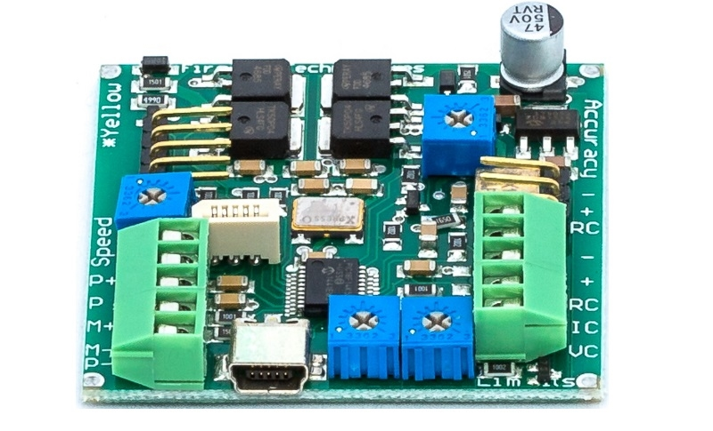
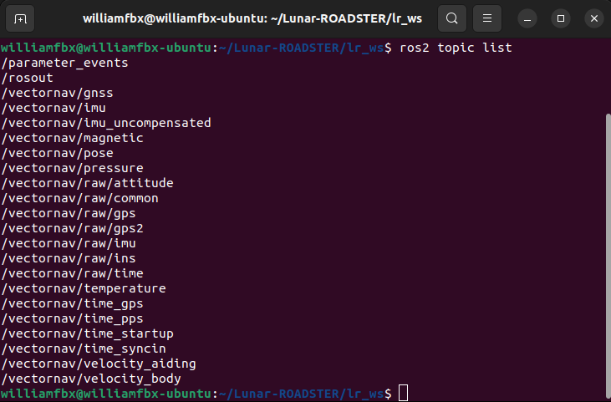
Status: Sensors Subsystem
Implementation:
IMU implemented using VectorNav ROS package
Wheel Encoder parsed using micro-ROS
Purchased actuator has a feedback potentiometer
Challenges:
Difficulty integrating ZED SDK drivers with docker container due to CUDA compatibility issues
IMU firmware drivers were outdated
Status: 50% Complete
IMU and Wheel Encoder finalized. ZED SDK and Actuator Feedback Sensor setup in progress.

Slide 19
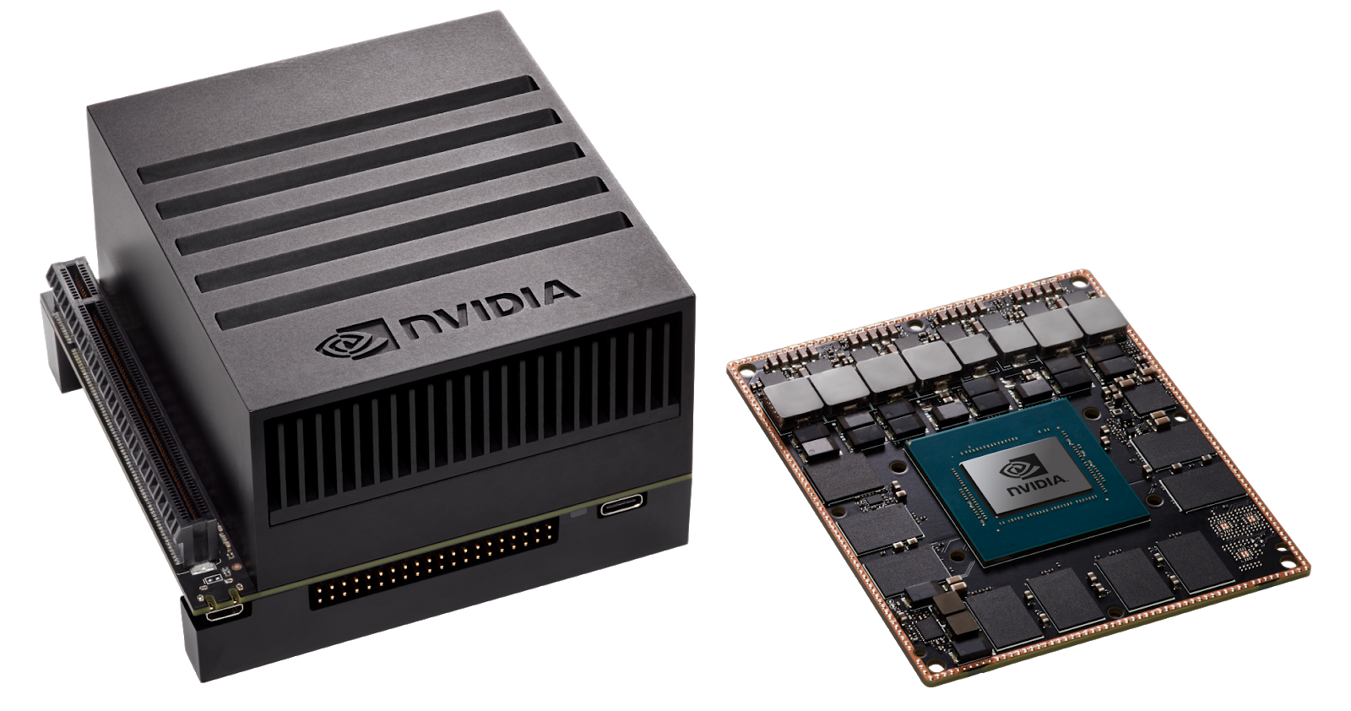
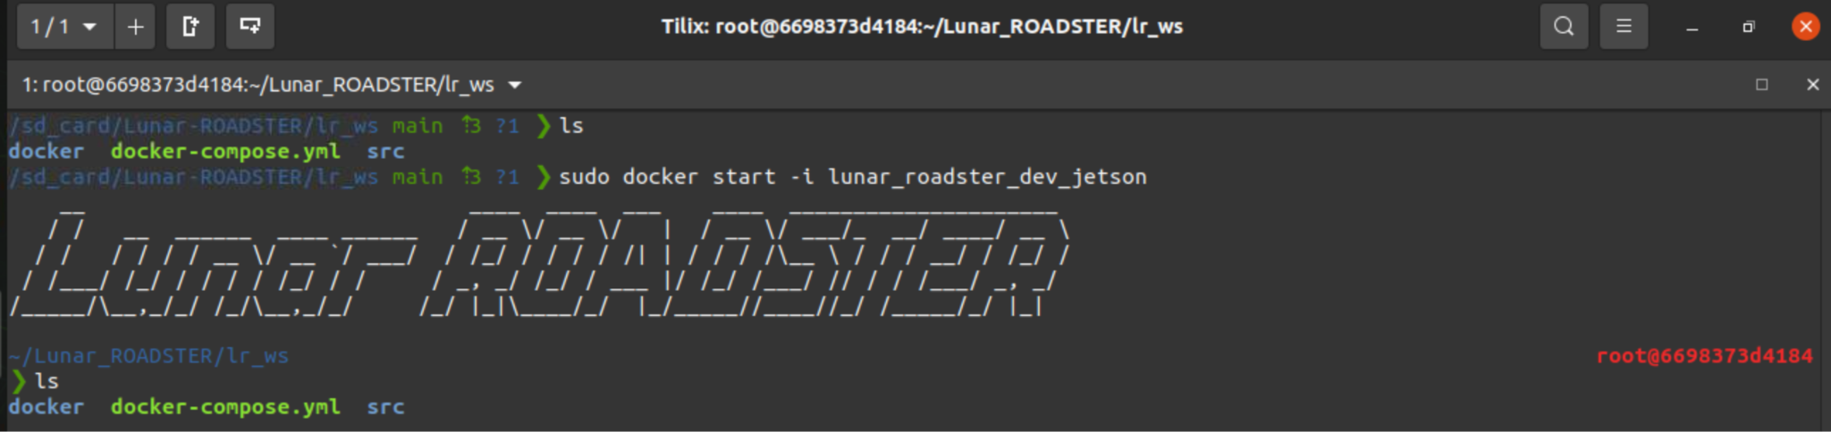
Description: Computations Subsystem
Jetson and Docker Unit
Description: Set up the Jetson with Docker running necessary packages
Requirements:
NVIDIA Jetson AGX Xavier
LAN Router
Team laptop (operations terminal)
Expected Functionality:
Serves as the on-board compute
Run ROS2 Humble
Run micro-ROS
Run all necessary packages and drivers

Slide 20
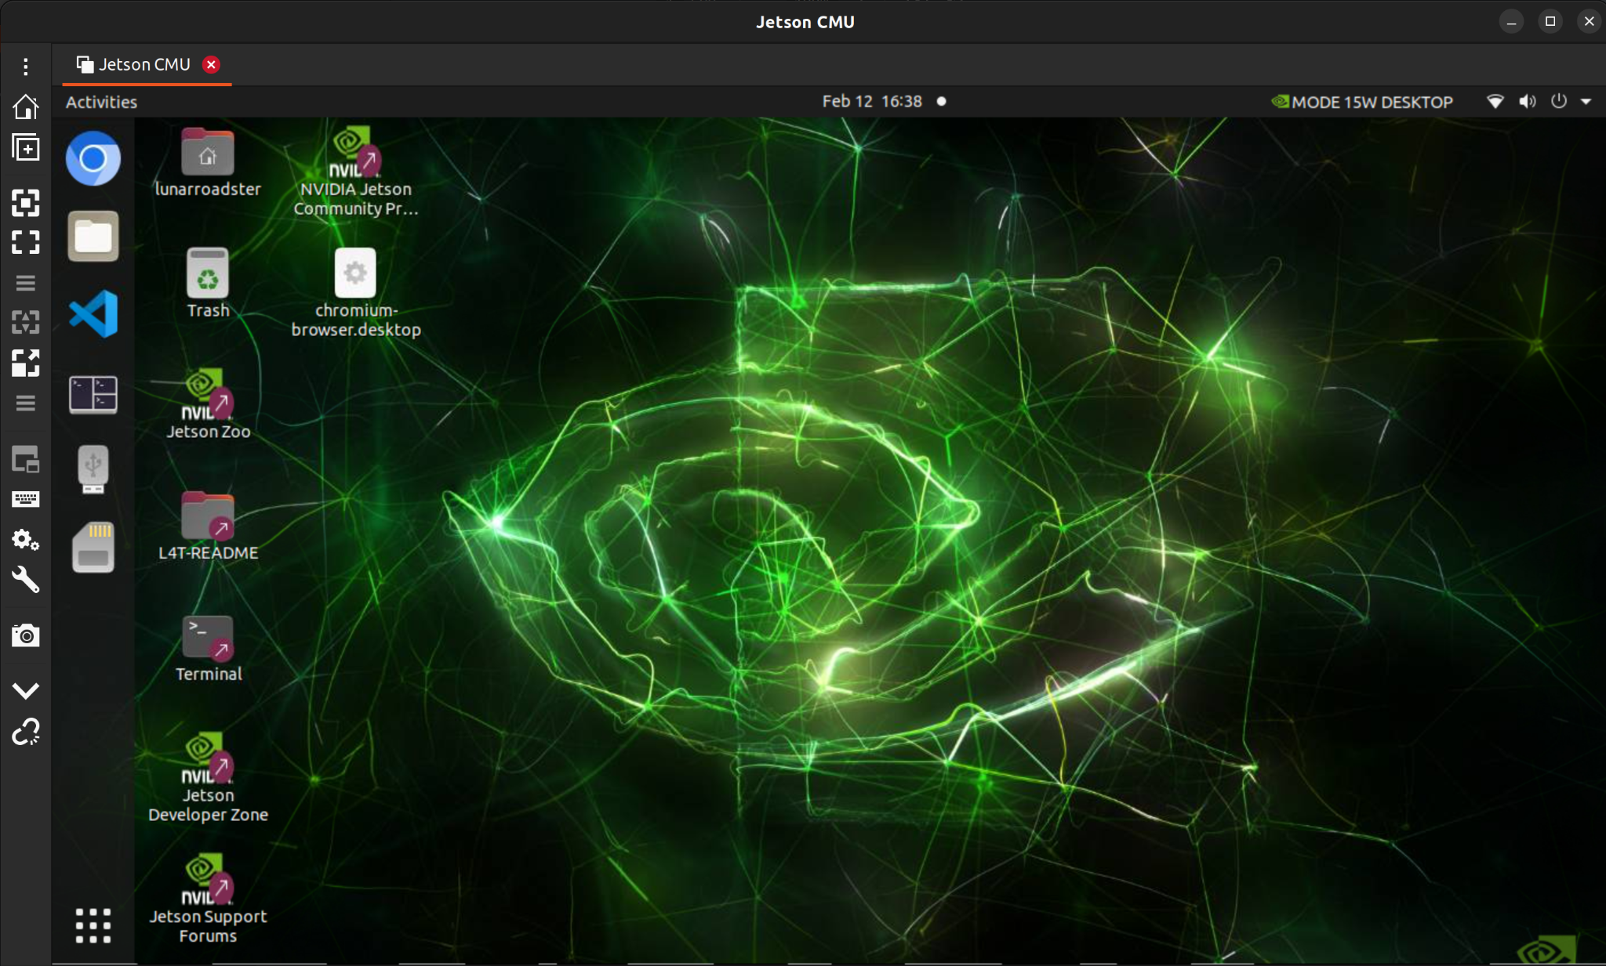
Status: Computations Subsystem
Jetson and Docker Unit
Implementation:
Connect Jetson to power source on rover
Established static IP on LAN network so operations terminal can communicate via SSH
Start docker container and run necessary packages
Challenges:
Setting up VNC server for remote access
Status: 95% Complete
Need to integrate ZED SDK drivers

Slide 21
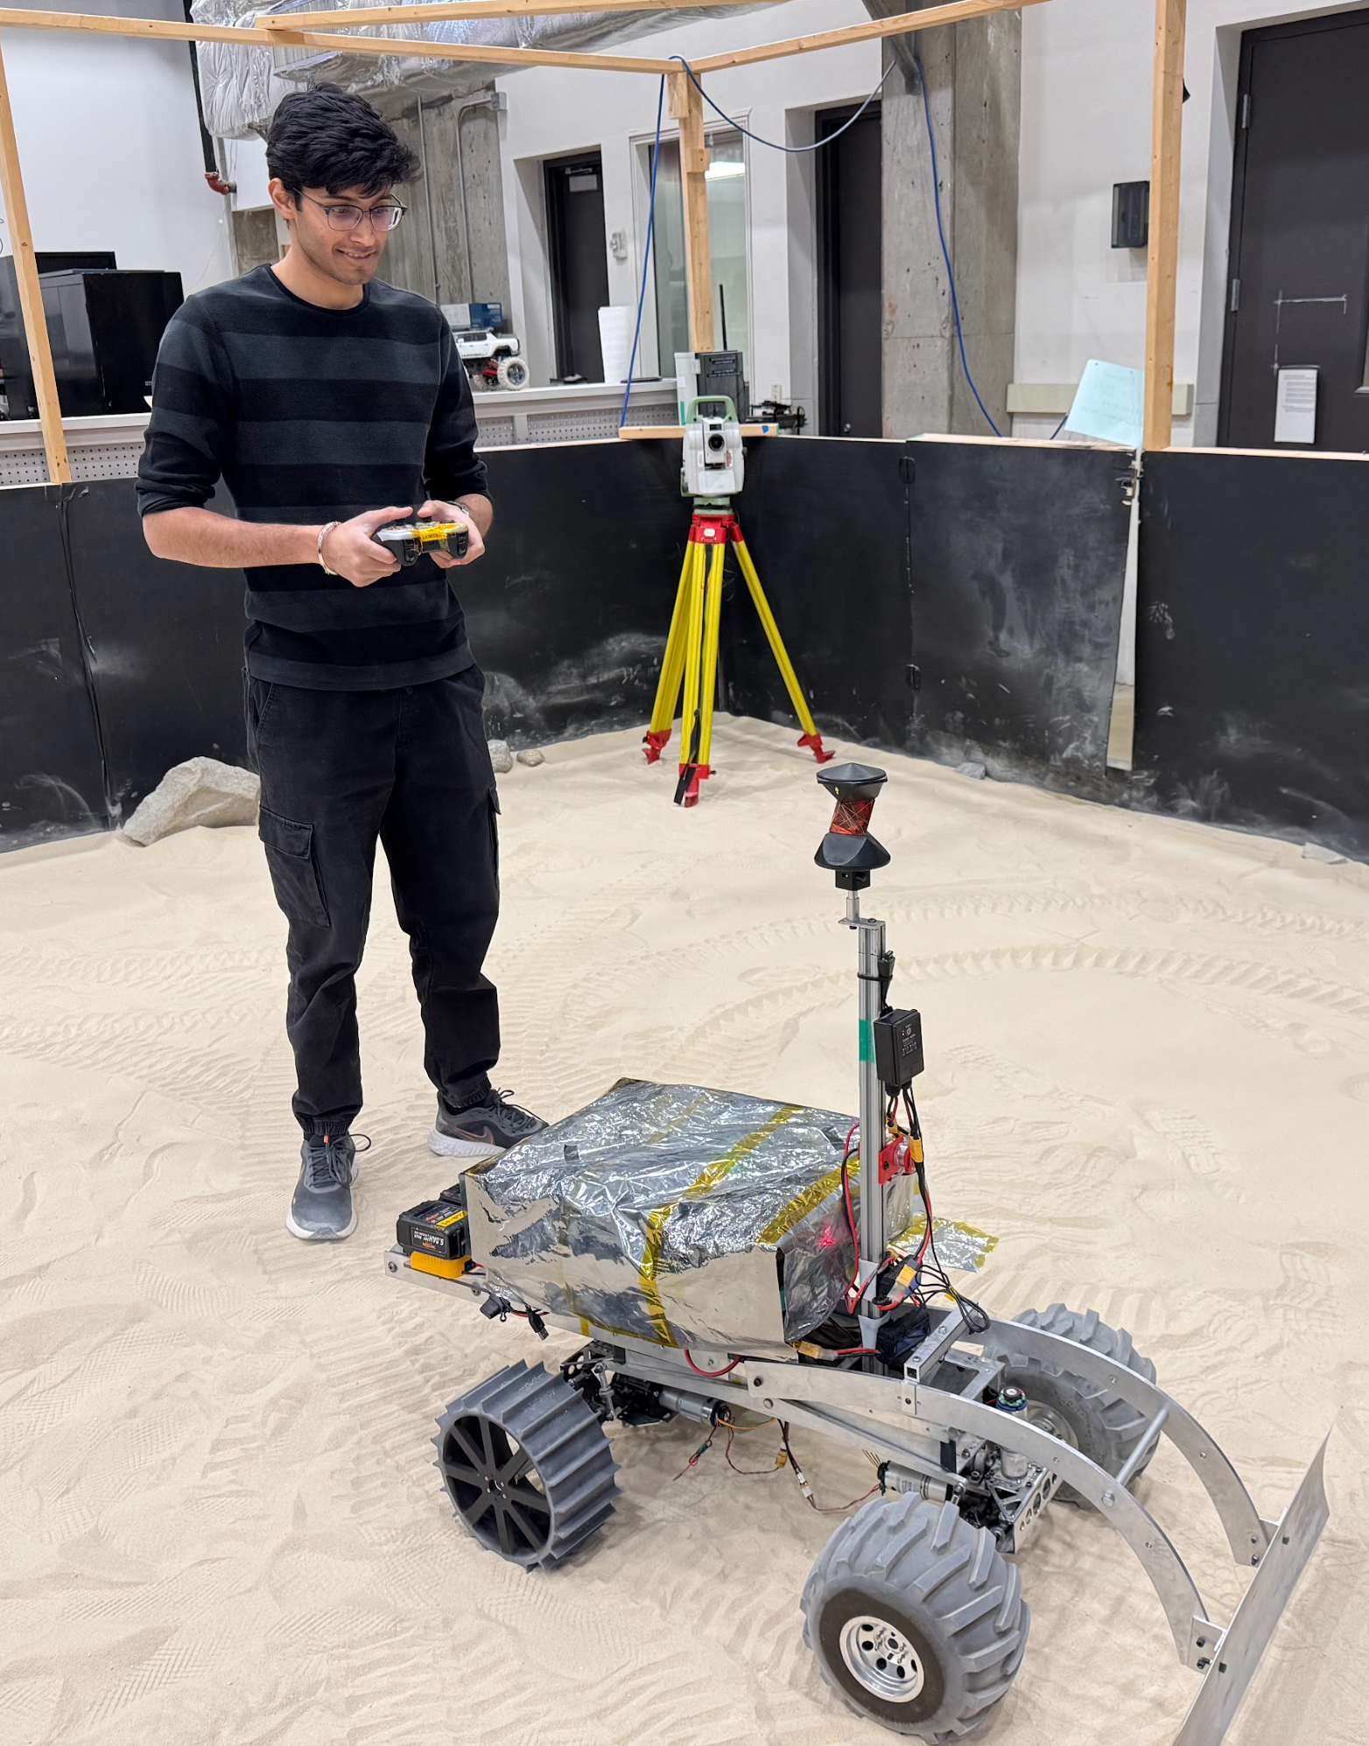
Description: Computations Subsystem
Localization Unit
Description: Localize the rover in the Moon Yard
Requirements:
Rover
Leica TS16 Total Station
NVIDIA TX2 Relay Chip
LAN Router
Team laptop (operations terminal)
Expected Functionality: Accurately localize rover pose inside the Moon Yard, to be used further for navigation

Slide 22
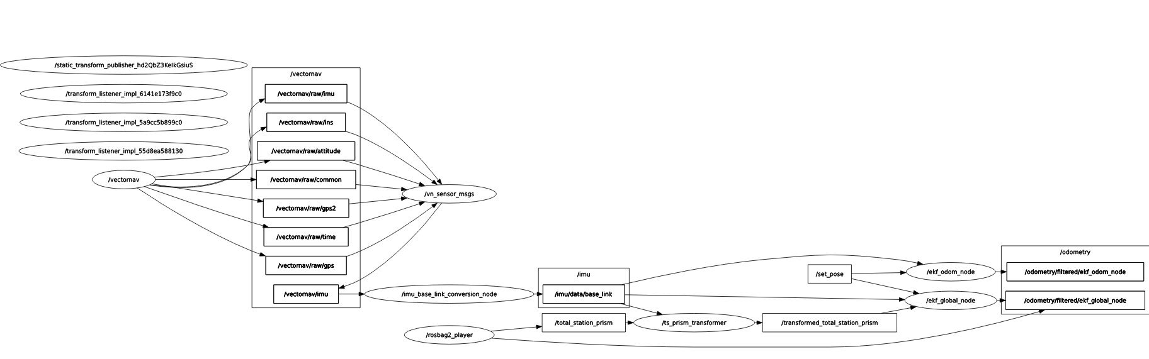
Status: Computations Subsystem
Localization Unit
Implementation:
On-board IMU and encoders used for local localization
Total station data fused with IMU and encoders for global localization
All frames are transformed to base_link
EKF runs using robot_localization package on Jetson
Challenges:
Incorrect Jetson Docker network permissions blocked two-way communication
Odometry keeps drifting away - EKF needs to be tuned
Status: 75% Complete

Slide 23
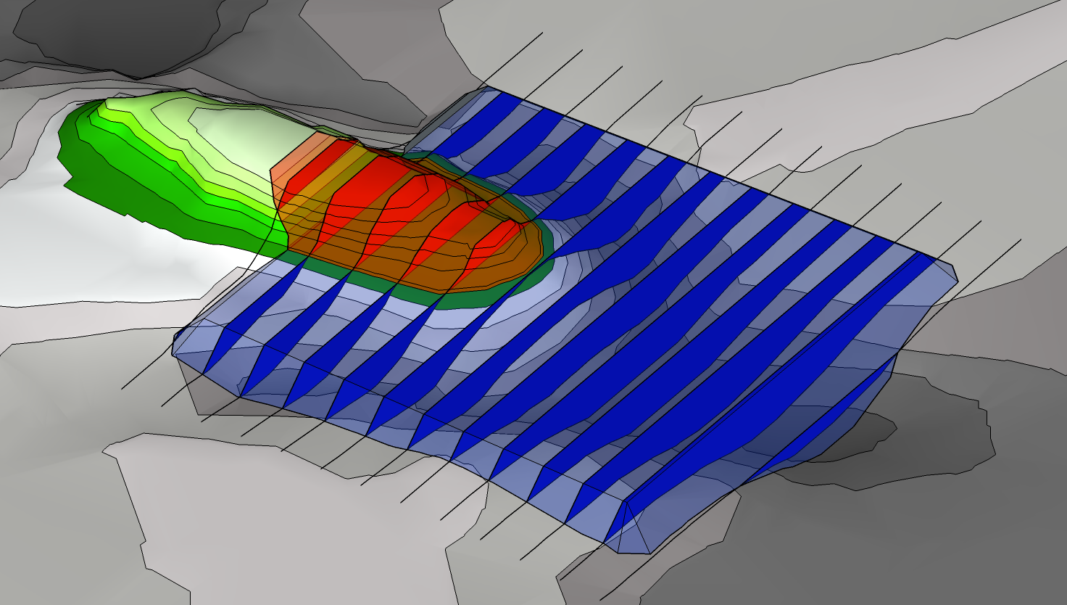
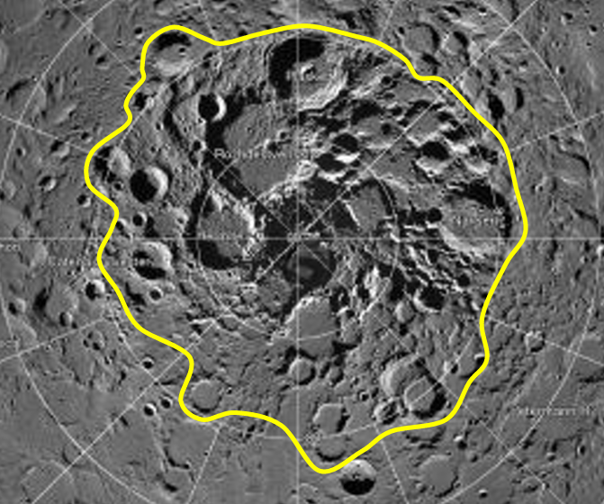
Description: Computations Subsystem
Tool Planner Unit
Description: Subsystem that plans sand manipulation by using the tool and drive train.
Requirements:
ZED 2i Stereo Camera
Jetson Xavier AGX
Dozer Assembly
Drivetrain (with Wheel Assembly)
Expected Functionality:
Plans a control input for the tool
Plans a trajectory for the rover for manipulation
Reports back when job is completed

Slide 24
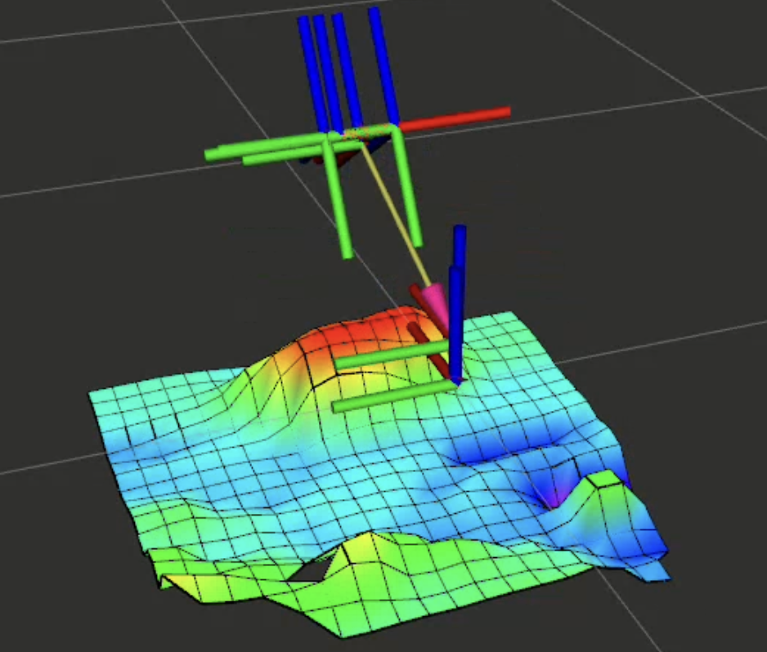
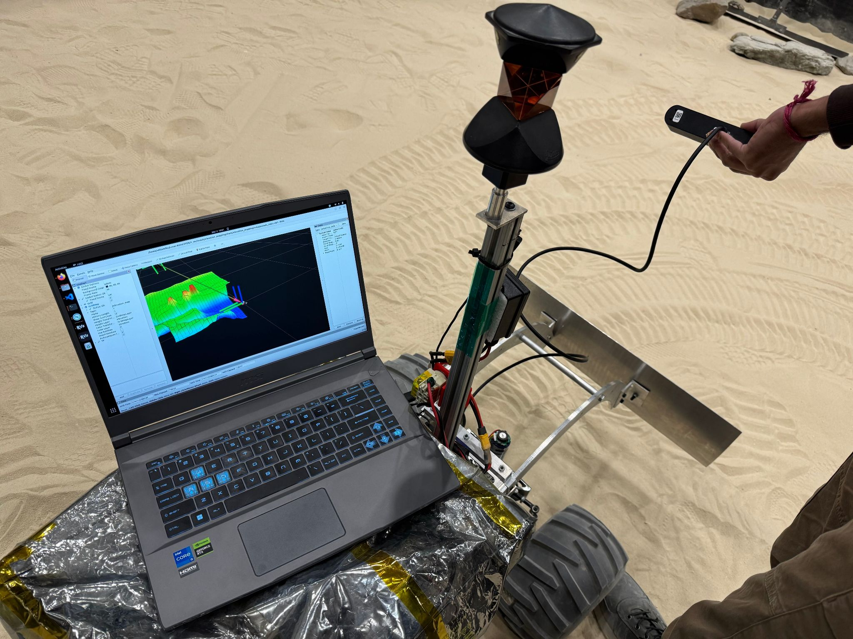
Status: Computations Subsystem
Tool Planner Unit
Implementation:
Integrated ZED 2i Stereo Camera with Elevation Mapping ROS package to create local elevation map.
Local map will be used to identify cut/fill regions
Path will be planned and integrated with the navigation planner
Challenges:
Trouble integrating ZED SDK packages with Docker container due to incompatible CUDA driver versions.
Status: 10% Complete

Slide 25
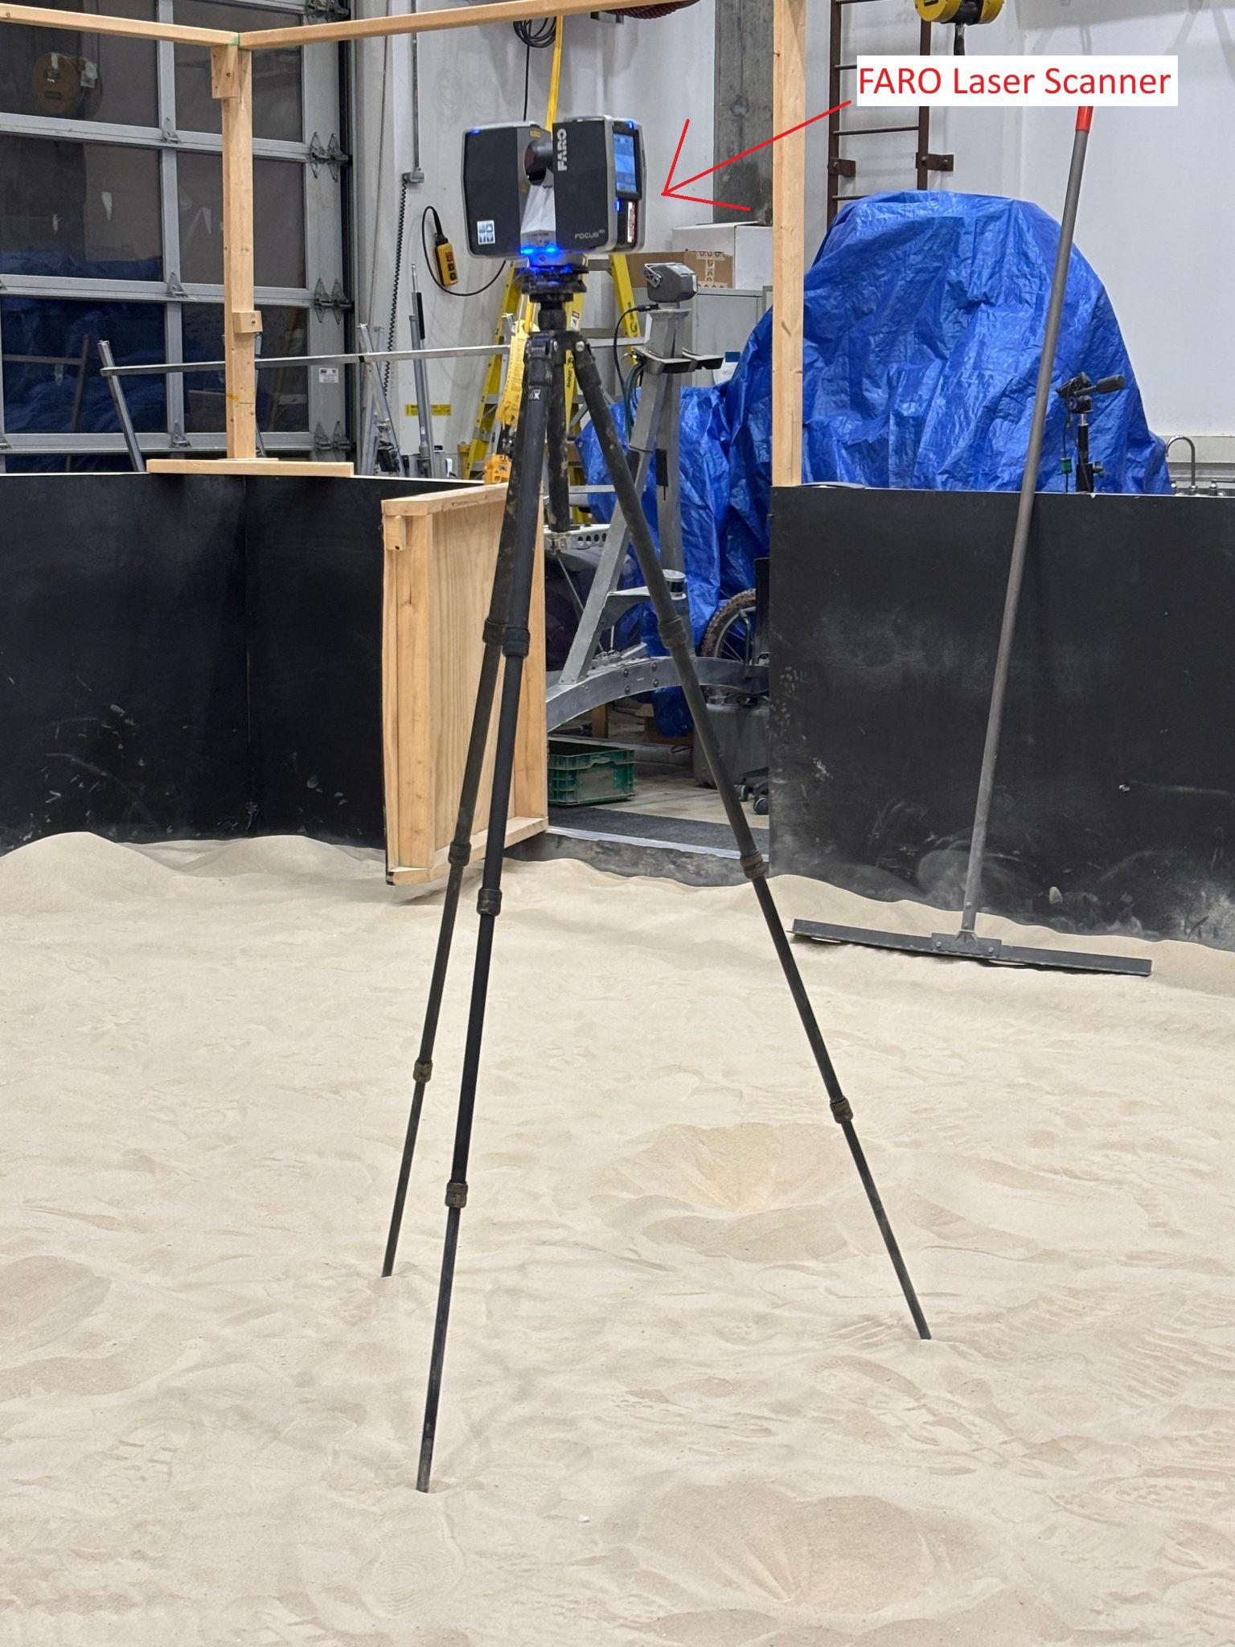
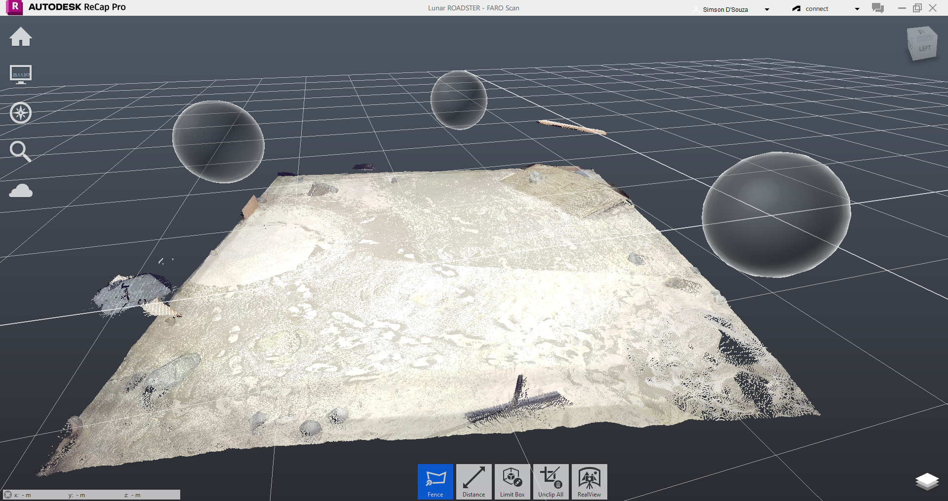
Description: Computations Subsystem
Navigation Planner Unit
Description: Identify gradable craters, obtain coordinates, and navigate the rover to their locations
Requirements:
FARO Laser Scanner
Zed 2i Stereo Camera
NVIDIA Jetson AGX Xavier
Team laptop (operations terminal)
Expected Functionality:
Accurately detect and classify gradable craters
Ensure no gradable crater is overlooked
Compute an optimal navigation path while avoiding obstacles (non-gradable craters and rocks)
Navigate and reach the goal location correctly

Slide 26
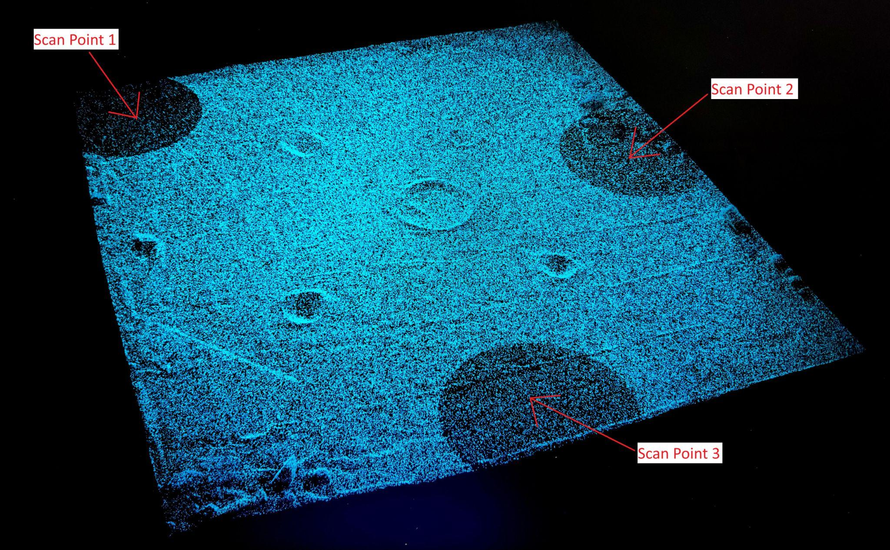
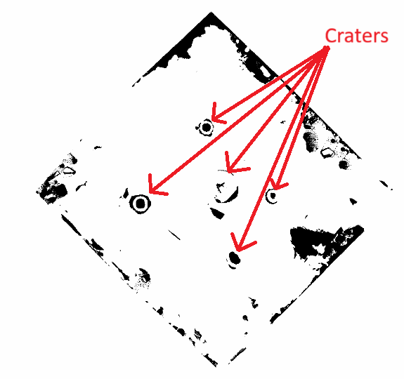
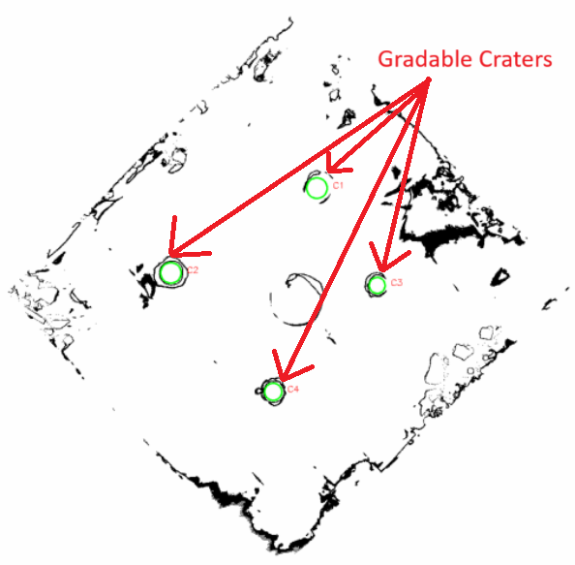
Status: Computations Subsystem
Navigation Planner Unit
Implementation:
Mapped the Moon Yard using the FARO Laser Scanner to generate a point cloud.
Converted the point cloud file into a ROS-compatible format.
Applied RANSAC for plane fitting and implemented thresholding to generate a 2D costmap for navigation.
Identified craters based on diameter and depth, extracting their coordinates.
Challenges:
FARO output file (.fls) was incompatible with the PCL library and ROS.
Plane fitting for identifying gradable craters was challenging due to uneven terrain.
Accurately classifying gradable craters based on diameter and depth.
Status: 30% Complete (Navigation Stack setup in progress)
Moon Yard Scan Visualization
Global Costmap
Identified Gradable Craters

Slide 27
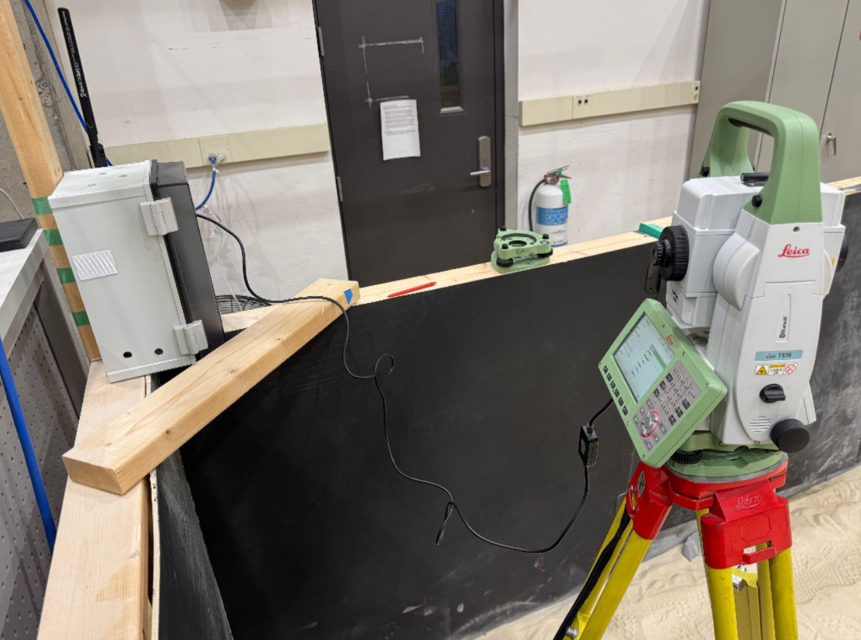
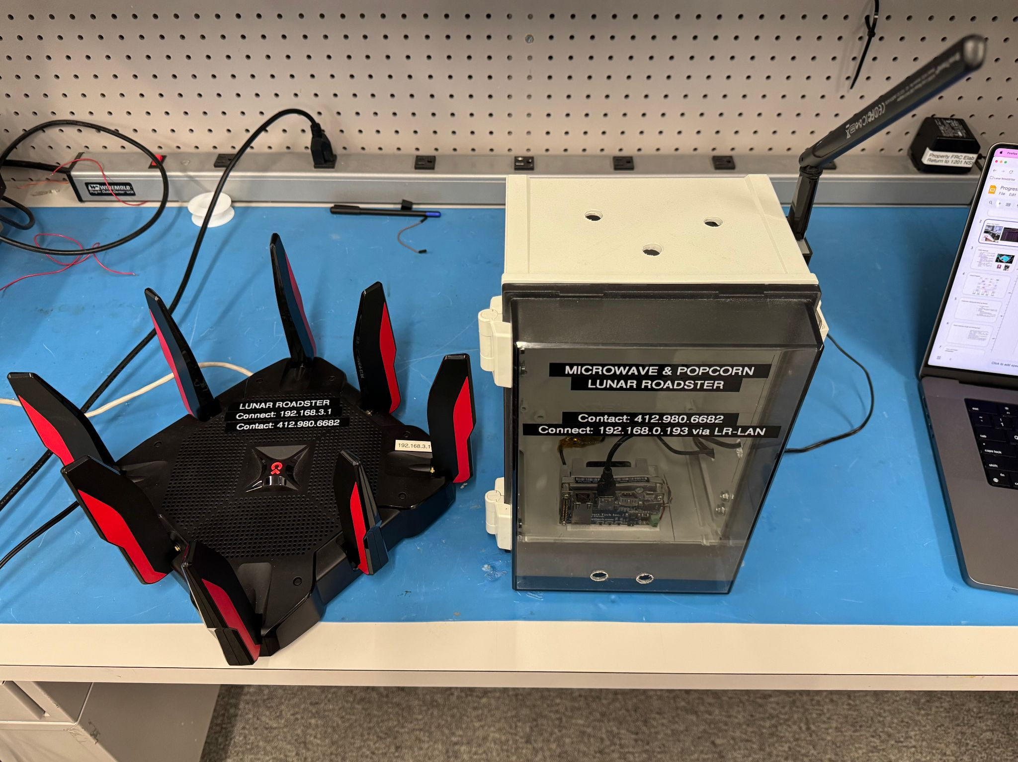
Description: External Infrastructure Subsystem
Description: Mission components that are offboard the rover.
Requirements:
Leica TS16 Total Station
NVIDIA TX2 Relay Chip
LAN Router
Team laptop (operations terminal)
Expected Functionality: Accurately localize {X, Y, Z}-coordinates of the rover inside the Moon Yard and establish two-way communication.
Notes:
The external infrastructure involves all mission components that are not on the rover. It is responsible for accurately localizing position of the rover inside the MoonYard.

Slide 28
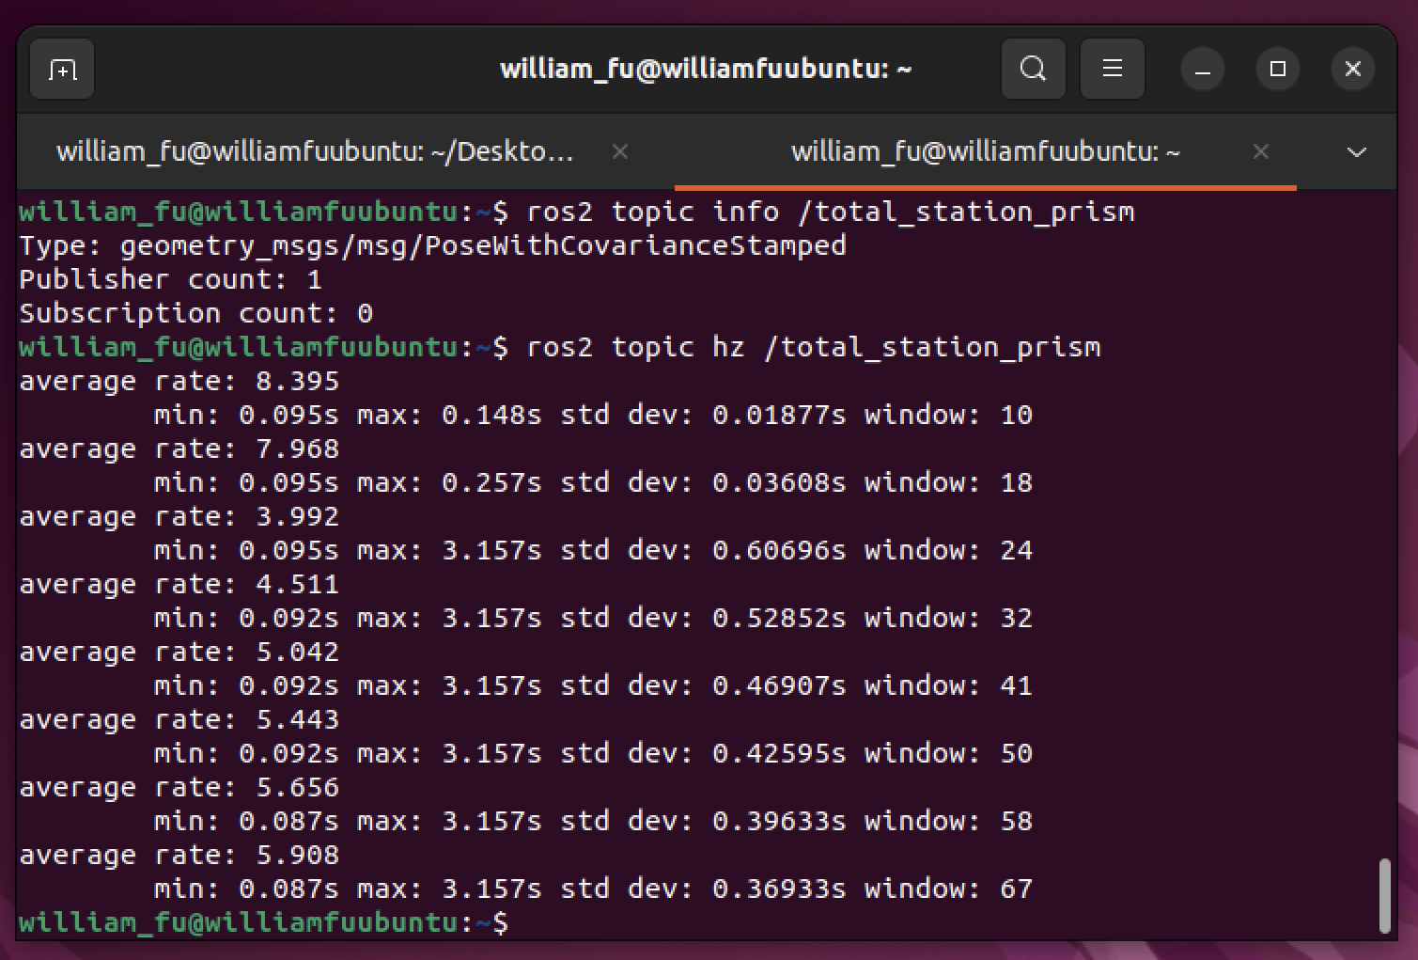
Status: External Infrastructure Subsystem
Implementation:
Total Station sends rover coordinates to TX2 relay chip, sends data packet via LAN network to rover.
Established static IP on LAN network so operations terminal can communicate via SSH.
Challenges:
Unable to obtain access to the TX2 relay chip login details
Incorrect Jetson Docker network permissions blocked two-way communication
Status: Completed
Notes:
Our implementation involves communication using a TX2 relay chip to the onboard Jetson. The challenges we faced our network permission and establishing static IP. The work in this subsystem is completed.

Slide 29
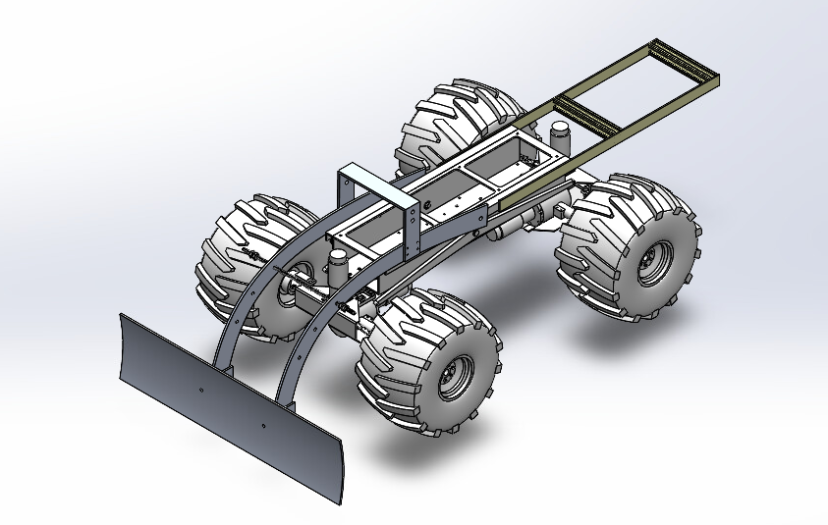
Description: Mechanical Subsystem
Dozer Assembly
Description: Lunar terrain manipulation tool
Requirements:
Dozer blade
Dozer arms assembly
Linear actuator
Arduino Due
Expected Functionality:
Perform dozing of sand
Perform backblading
Actuate automatically based on commands from tool planner
Notes:
Dozer Assembly is our lunar manipulation tool that will automatically perform dozing and backblading of sand based on commands from the tool planner.

Slide 30
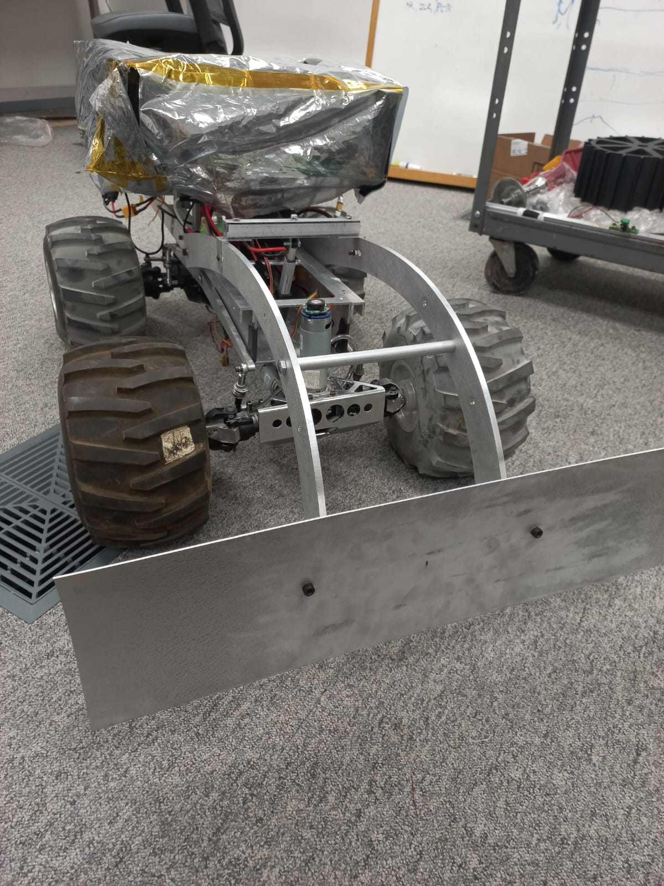
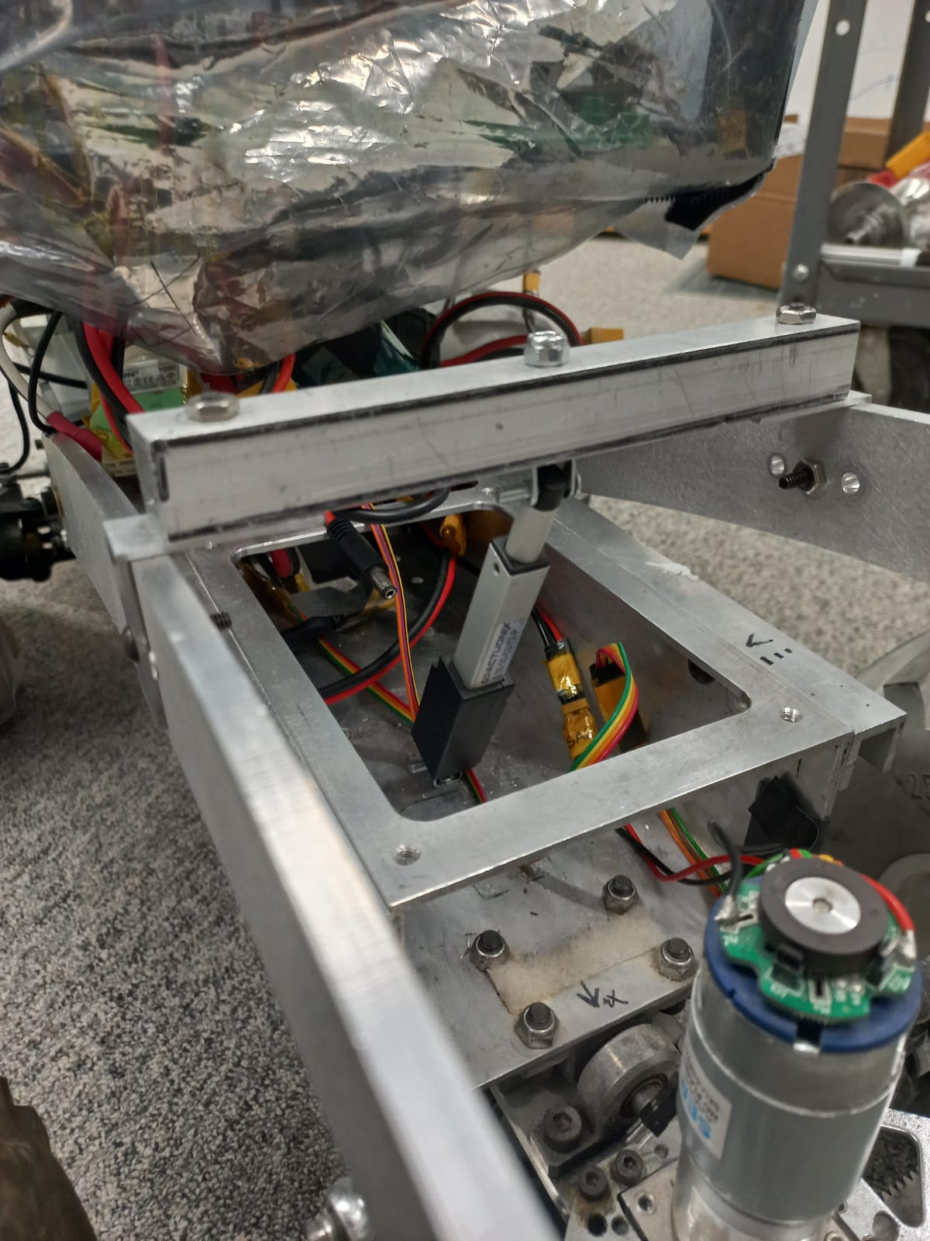
Status: Mechanical Subsystem
Dozer Assembly Unit
Implementation:
Research: Dozer shapes and sizes, actuation methodologies.
Designed the dozer assembly (blade, arms, yoke, mounts) using SolidWorks.
Shortlisted linear actuators of different gear ratios.
Manufactured and assembled all parts on the rover.
Testing with different actuators
Challenges:
Fabrication problems
Limited access to FRC Workshop
Status: 85% Complete
Refining assembly
Notes:
Our implementation involved research, mechanical design and manufacturing the dozer. The challenges we faced are fabrication issues and limited workshop access. The task remaining is refining the dozer assembly.

Slide 31
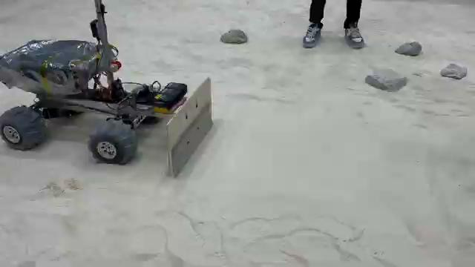
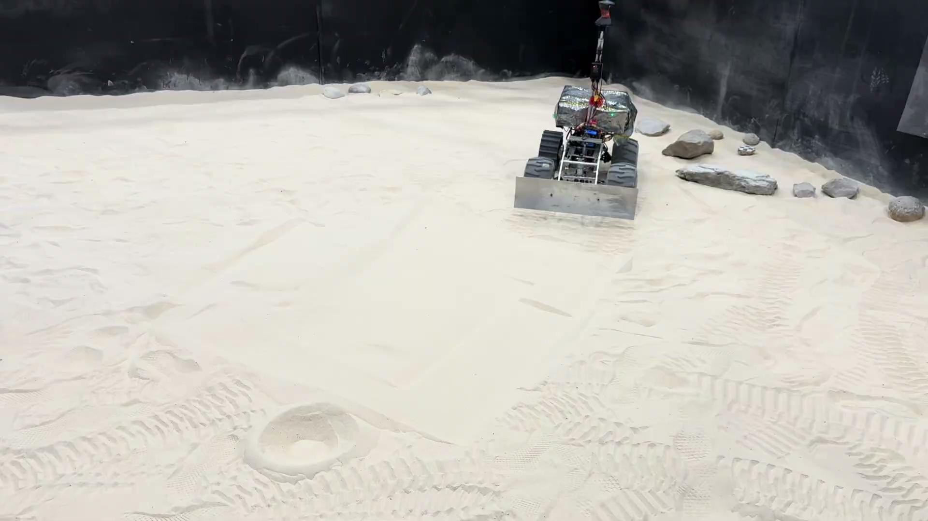
Status: Mechanical Subsystem
Dozer Assembly Unit
Notes:
These videos the development progress through iterative design.

Slide 32
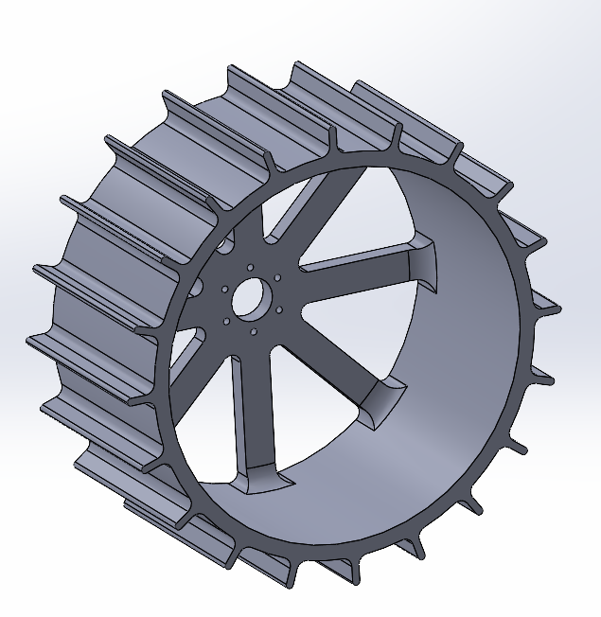
Description: Mechanical Subsystem
Wheel Assembly Unit
Description: Assembly that enables movement of the rover by acting as an interface between the drivetrain and ground.
Requirements:
Wheel (3D Printed/Metal)
Mounting Assembly to the Suspension
Drive Train (Differential and Steering)
Motors
Expected Functionality:
Provide required traction for movement and grading of sand
Minimize wheel slip
Allow for steering in sand
Desirable - Use materials that can function on the Lunar Surface
Notes:
Due to the low-friction Lunar terrain, we modified our wheel design with a focus on maximizing traction, minimizing slip and allowing for efficient steering.

Slide 33
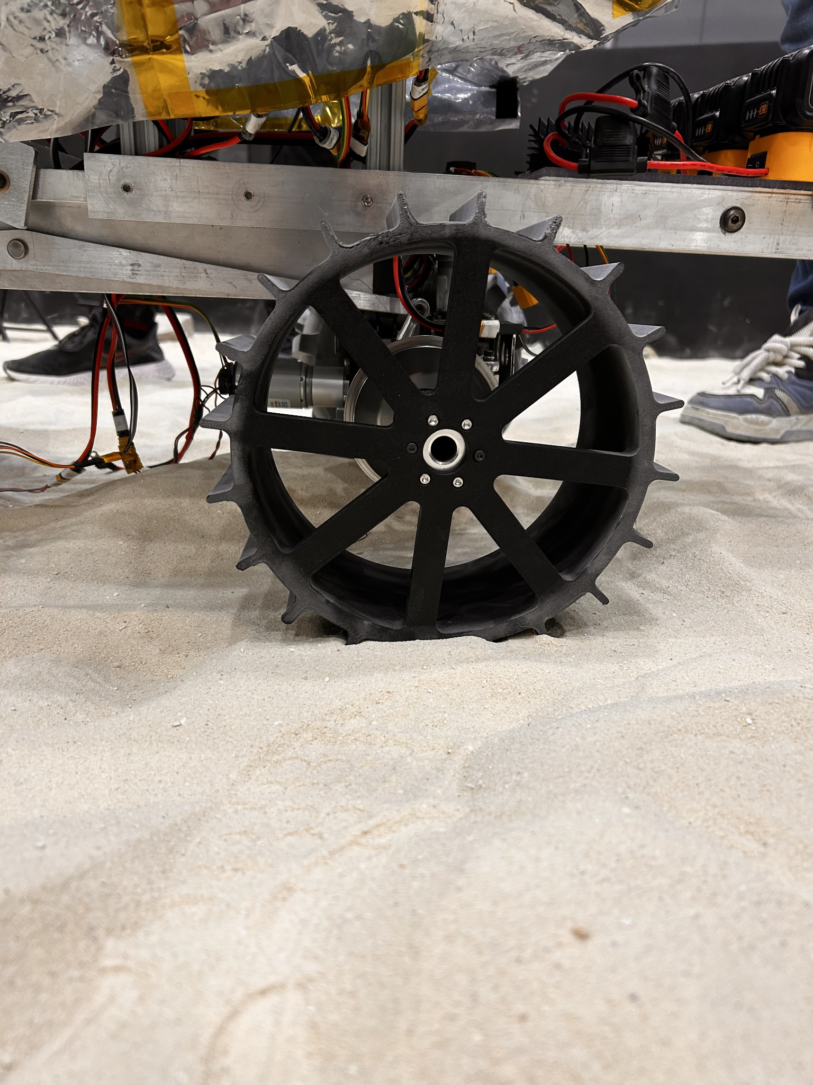
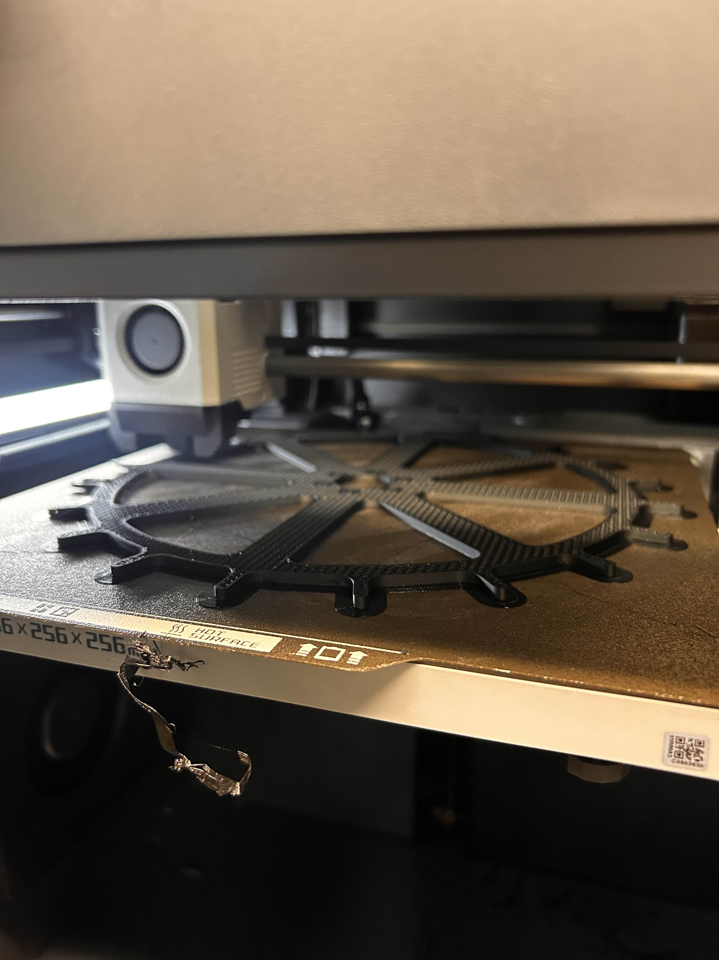
Status: Mechanical Subsystem
Wheel Assembly Unit
Implementation:
Research: Grouser shapes and patterns ideal for traction in sand
Design single-part iterations in SolidWorks
3D-print designs and test in the MoonYard
Observe and re-design until the design is satisfactory
Finalize design and manufacture using aluminium.
Stretch Goal: Use the wheel test bed in PRL to accurately measure performance
Challenges:
3D Printing the wheel is a long process with frequent failures
Steering system of the rover is fragile and frequently disengages
Status: 50% Complete
Iteration 2 performs better than the stock rubber wheels
Next test will be using 4 3D-printed wheels
Notes:
Our implementation involved research rover wheel design and rapid prototyping through 3D printing. The challenges involved the long printing process, and the fragile steering system due to wear and tear. The current iteration performs better than the stock rubber wheels and we will test using all 4 wheels.

Slide 34
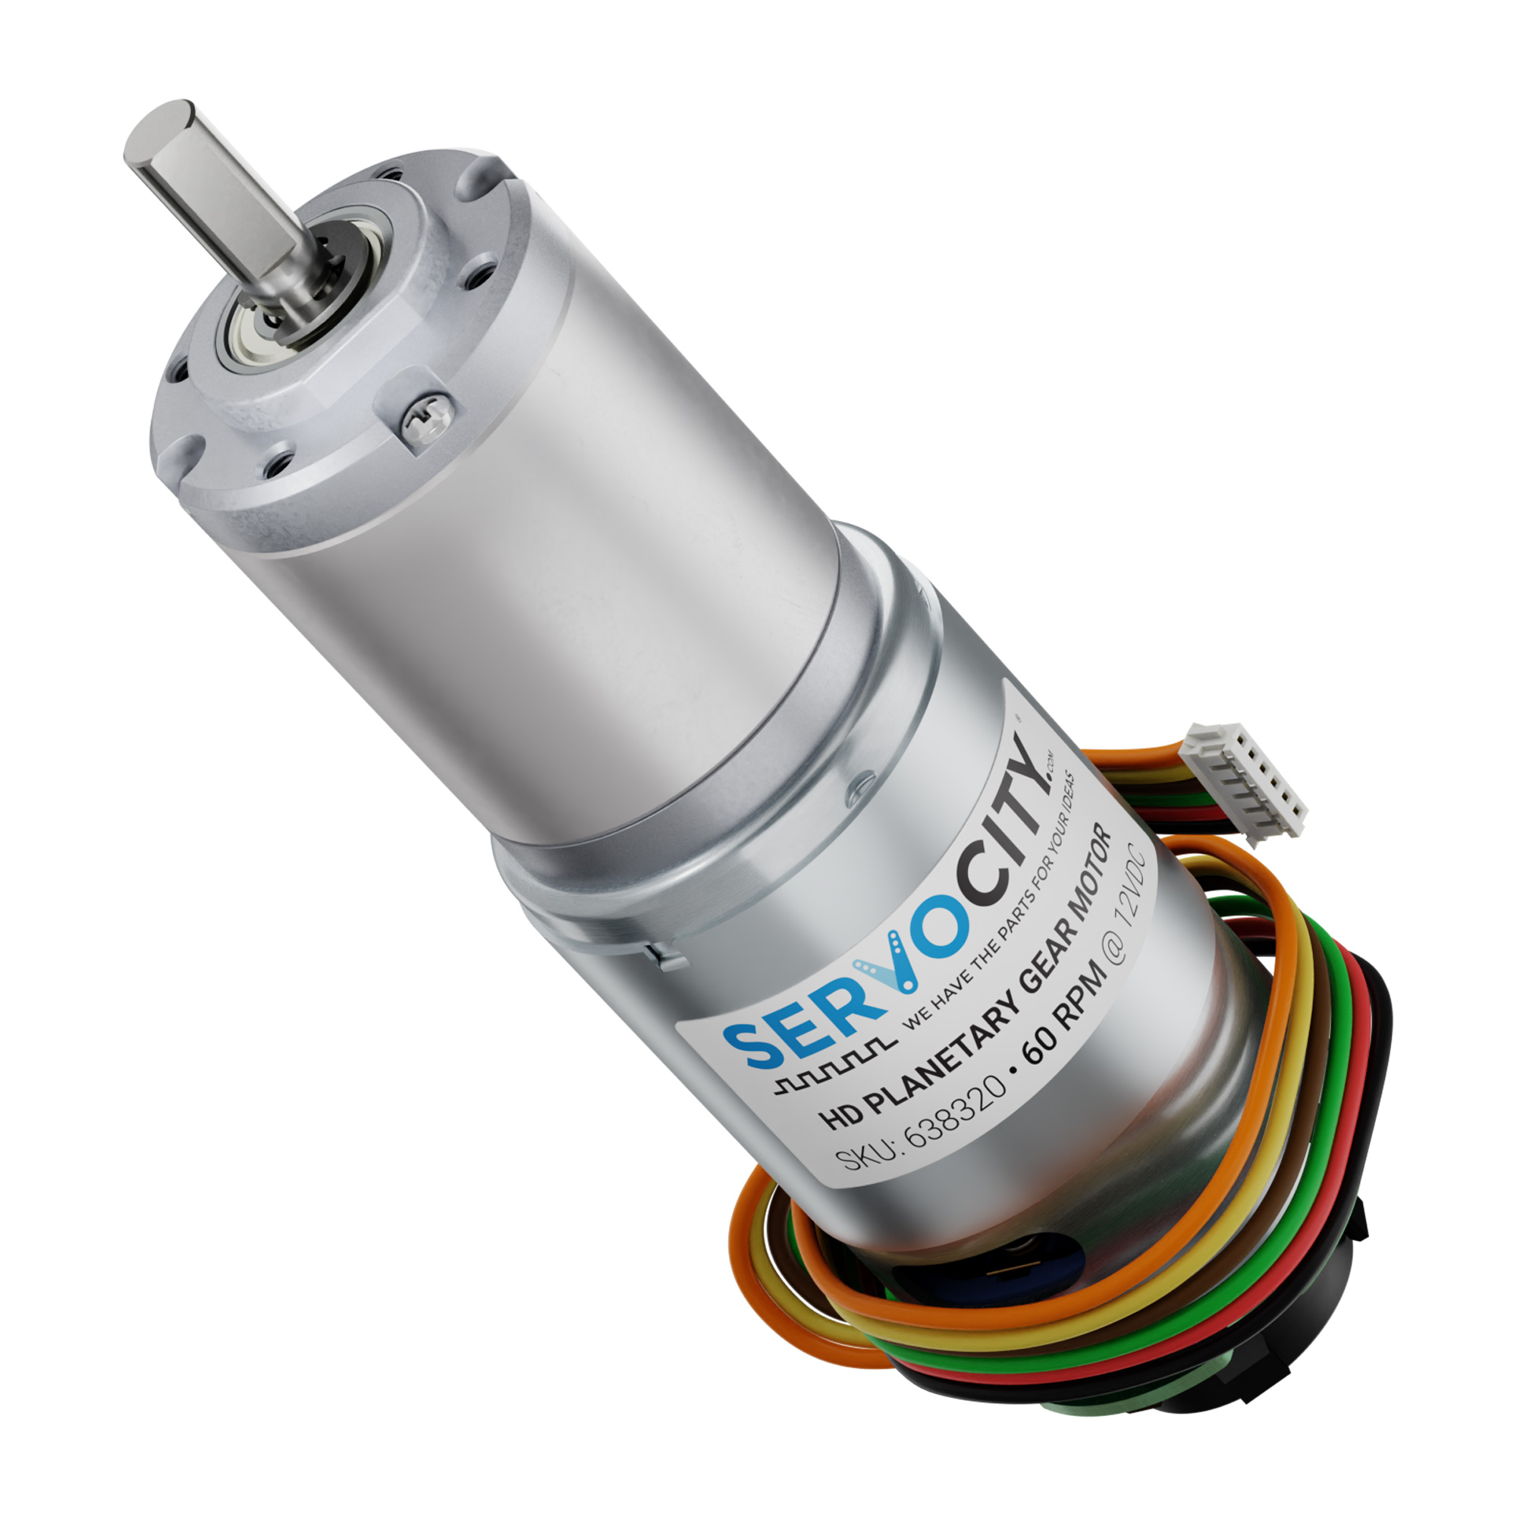
Description: Actuation Subsystem
Description: Power transfer methodologies for rover mechanisms.
Requirements:
DC Motors with Encoders (x4)
Linear Actuator (with feedback)
Expected Functionality:
Deliver power to wheels for mobility
Steer the front and rear wheels
Actuate the dozer assembly to facilitate mobility and dozing
Notes:
The actuation subsystem is responsible for delivering power to all motors and actuators.

Slide 35
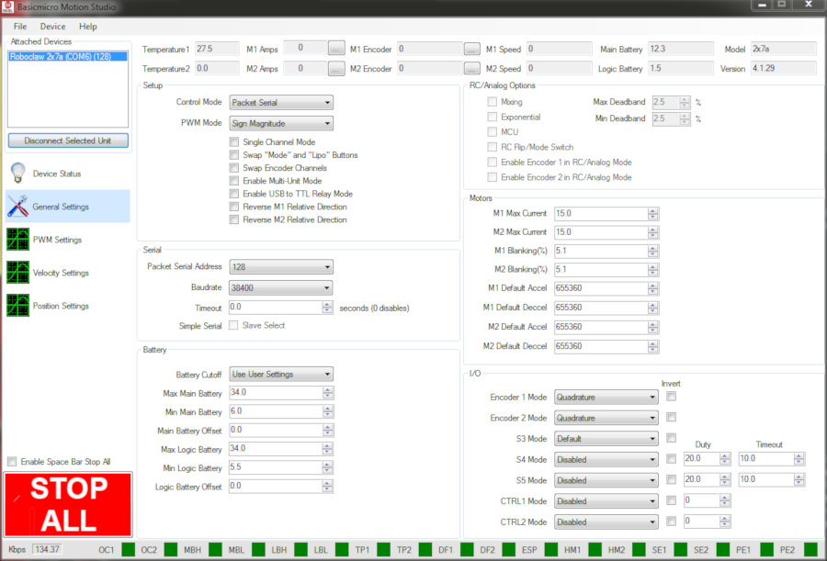
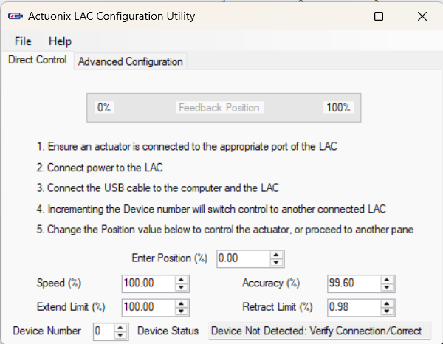
Status: Actuation Subsystem
Implementation:
Selected drive motors with higher torque for better traction and mobility
Selected linear actuator for dozer assembly
Interfaced drive motors and steering motors with Roboclaw motor controller
Interfaced Actuator with Linear Actuator Controller Board and Arduino Due
Challenges:
Encoder QPPS to be changed using RoboClaw due to change in motors for better teleop and navigation
Oscillations near setpoint of linear actuator under load.
Status: 85% Complete
Tuning of actuator gains to reduce oscillations
Notes:
Our implementation involves sourcing and interfacing actuators using their respective drivers. The challenges we faced are calculating accurate QPPS values and minimising actuations. Our next task involves tuning the PID to minimize actuator oscillations.

Slide 36

Description: Electrical Subsystem
Description: Rover’s power and logic circuitry.
Requirements:
Buck Converter (20 V -> 12 V)
Power Distribution Board (PDB)
RoboClaw Motor Controller - 2
Linear Actuator Controller
Linear Actuator
Zed 2i Depth Camera
E-Stop
Wireless Switch
IMU - VectorNav VN100
Arduino Due
Nvidia Jetson Xavier AGX
Wireless Receiver for Joystick
DC motors with Encoders
Expected Functionality:
Distribute power efficiently to all rover components
Ensure stable voltage levels for uninterrupted operation
Electrical Circuitry
Notes:
The electrical subsystem is the rover’s power and logic circuitry. It ensures stable voltage levels for robust operation.

Slide 37


Status: Electrical Subsystem
Implementation:
Analyzed the existing circuit connections of the rover designed by the Crater Grader team.
Modified circuit connections to integrate new electrical components.
Assessed the power requirements of the components to design a custom Power Distribution Board (PDB).
Designed a compact and accessible electronic box to streamline the electrical subsystem setup.
Challenges:
Understanding and adapting to the existing circuit design and limitations.
Ensuring the compact design of the electronic box while maintaining accessibility and proper cooling.
Status: 50%
Manufacturing of the electronic box is in progress.
Power Distribution Board (PDB) manufacturing and integration are planned.
Electronics Assembly Design
Notes:
We analyzed existing connections and modified them to our requirements. We designed a compact electronics box to minimize space taken and maximize accessibility. Our main challenge was to ensure that the box design allows for proper cooling. We are currently manufacturing the e-box and plan to integrate the PDB.

Slide 38

Work Breakdown Structure
Notes:
Broadly based on our subsystems
Grader not required, backblading instead
PDB in electronics is new, Read Sensor Data using Jetson in Sense is new

Slide 39

Schedule
PDR
Dozer Complete
External
Infrastructure Complete
Electrical Power Complete
Localization Complete
Navigation & Tool Planner Complete
SVD

Slide 40
Spring Test Plan
Date | Event | Capability Milestones | Tests | Requirements
03/20 | PR3 | Rover can localize itself accurately Sensor placement do not block tool operations Rover can navigate autonomously Tool can operate autonomously | T09 T10 T11 T12 | M.F.2 M.F.3 M.F.4 M.F.6 M.F.7
04/08 | PR4 | Subsystems and units operate when integrated Integrated subsystems do not hinder each other Rover is operable as a system Failing or degraded parts on rover is replaced | T13 T14 | M.F.2 M.F.9
04/17 04/24 | PR5 (SVD) PR6 (Encore) | System can operate autonomously System can localize itself System can navigate autonomously System can traverse the Moon Yard without getting stuck System can grade suitably sized craters and dunes System updates the operations terminal regarding progress | T15 | M.F.2 M.F.3 M.F.4 M.F.5 M.F.7 M.F.9

Slide 41
Fall Test Plan
Month | Capability Milestones | Tests | Validation
August | Rover quality assurance after summer break and enhancement of the rover’s facade | Check all subsystems and units are functioning correctly | The rover is able to complete all tasks from Spring
September | Integrate the validation stack for the dozing performance | Present craters of various groomed gradients to the validation stereo camera. The camera should output the perceived gradient and inform the operations terminal of the groomed status of the crater | The rover correctly informs operations terminal on whether the crater is dozed successfully or not
October | Implement new localization stack using no external infrastructure (will use pseudo star-sun tracker) | The rover is able to accurately localize itself in the Moon Yard without external infrastructure | Localization is accurate and comparable to current total station implementation
November | Integrated entire system for circumnavigation dozing of craters | Present several craters in a circular path in the Moon Yard. The rover should avoid ungradable craters and grade suitable craters specified in our performance requirements (M.P.4 and M.P.5) | The rover successfully navigates circular path and dozes suitable craters

Slide 42
SVD and FVD Split
Spring Validation Demo | Fall Validation Demo
ROADSTER uses the excavator to groom one crater in a simple, straight path in the Moon Yard. | ROADSTER uses the excavator to groom multiple craters and create a circuitous path around the Moon Yard.
This will be our Minimal Viable Product with simplified localization and path planning. | This will include more ambitious tasks such as Lunar-accurate environments and localization through Visual Odometry / Structure-for-Motion / Star-Sun Tracker

Slide 43
Spring Validation Demonstration
Test Location
Planetary Robotics Lab Moon Yard
Sequence of Events
Prior Setup: Prepare the Moon Yard with a suitable crater and dune. Scan the Moon Yard with a FARO Scanner to obtain a global map for navigation. Attach and connect all the components and subsystems of the rover. Set up the external infrastructure such as the total station in the corner of the Moon Yard, the LAN router, and the TX2 relay. Place the rover in the Moon Yard and calibrate its localization using the total station. During Demonstration: Turn on the rover and SSH into the Lunar ROADSTER docker on the operations terminal laptop. Switch the rover to autonomous mode and run the start-up procedure. Observe the rover autonomously grade one crater and level one dune. If anything unexpected occurs press the emergency stop button.
Quantitative Performance Metrics
M.P.1: Will plan a path with cumulative deviation of <= 25% from chosen latitude’s length M.P.2: Will follow planned path to a maximum deviation of 10% M.P.4 (Part 1): Will avoid craters >= 0.5 metres M.P.5: Will fill craters of up to 0.5 meters in diameter and 0.1m in depth
Follow a straight path
Groom one crater

Slide 44
Fall Validation Demonstration
Test Location
Planetary Robotics Lab Moon Yard
Sequence of Events
Prior Setup: Prepare the Moon Yard with several craters and dunes in a circular path. Scan the Moon Yard with a FARO Scanner to obtain a global map for navigation. Attach and connect all the components and subsystems of the rover. Place the rover in the Moon Yard and calibrate its localization using a star-sun tracker or visual odometry. During Demonstration: Turn on the rover and SSH into the Lunar ROADSTER docker on the operations terminal laptop. Switch the rover to autonomous mode and run the start-up procedure. Observe the rover autonomously grade craters and level dunes in a circular path. After each dozed crater, use the ZED camera to validate whether the dozing satisfies the performance requirements. If anything unexpected occurs press the emergency stop button.
Quantitative Performance Metrics
M.P.1: Will plan a path with cumulative deviation of <= 25% from chosen latitude’s length M.P.2: Will follow planned path to a maximum deviation of 10% M.P.3: Will climb gradients up to 15° and have a contact pressure of less than 1.5 kPa M.P.4: Will avoid craters >= 0.5 metres and avoid slopes >= 15° M.P.5: Will fill craters of up to 0.5 meters in diameter and 0.1m in depth M.P.6: Will groom the trail to have a maximum traversal slope of 5°
Follow a circular path
Groom several craters in a circular path

Slide 45

Budget
Major Items | Units | Total Price
ZED 2i Stereo Camera | 1 | $562.00
DC/DC Power Converter | 1 | $315.51
Planetary Gear Motors | 4 | $239.96
Linear Actuators | 3 | $290.00
MRSD Budget | MRSD Budget Spent ($) | MRSD Budget Spent (%) | Total Budget Spent* | Remaining Balance
$5,000 | $2,059.92 | 41.20% | $5,129.92 | $2940.08
* Includes items inherited from Crater Grader and Supervisor

Slide 46

Risk Management (Previously)
Risk Summary
R14
R10
R2, R11
R4, R19
R12, R24
R5, R7,
R20, R23,
R26
R16
R3, R6
R1
Notes:
We initially identified several risks, but as the project progressed, some became irrelevant, while others needed modification.

Slide 47
Risk Management (Updated)
Risk Summary
R14
R10
R2, R11
R19
R12, R24
R30
R5, R7,
R20, R23,
R26, R27
R16, R28
R3, R6
R1
Notes:
This is our updated risk summary

Slide 48
Risk Management (Updated)
Reduced Risk Summary
R14
R10
R2, R30
R5,
R12, R19, R23, R27
R3, R6, R11
R26
R24, R28
R7
R20
R1, R16
Notes:
This is our updated reduced risk summary, allowing us to focus on the crucial ones

Slide 49
Top Previous Risks
Risk ID | Risk Title | Risk Owner | Risk Type: | Technical
R2 | Dozer tool planner takes longer than expected to deliver | Simson
Description |  | Date Added
Implementation and integration of the Dozer tool planner takes longer than expected |  | 11/27/2024
 |  | Date Updated
 |  | 3/9/2024
Consequence
Unable to meet SVD deadline and potential requirements change
Action/Milestone |  | Success Criteria | Date Planned | Date Implemented
Shift requirements for SVD |  | Updated performance requirements | 11/28/2024 | 11/28/2024
Potentially use off-the-shelf code if available, preferably from CraterGrader |  | Successful integration of off-the-shelf components
Notes:
We identified key risks along with mitigation strategies, assessing their severity in terms of consequence and likelihood. These include:

Slide 50
Top Previous Risks
Risk ID | Risk Title | Risk Owner | Risk Type: | Technical
R3 | Integration issues between subsystems | Deepam
Description |  | Date Added
Subsystems work individually, but integration and communication between the subsystems are flawed |  | 11/27/2024
 |  | Date Updated
 |  | 11/27/2024
Consequence
Delay in integration causing scheduling overruns, requirements change and failure of the demo
Action/Milestone |  | Success Criteria | Date Planned | Date Implemented
Perform unit testing and subsystem validation continuously |  | Successful testing of all major subsystems | 11/30/2024
Integrate one subsystem at a time |  | Successful integration of all major subsystems | 11/30/2024
Use a common framework (e.g. ROS2 interfaces) for communication between subsystems to reduce bugs |  | Adoption of common framework for communications | 11/30/2024
Keep to planned schedule and have at least 5 weeks for testing and integration |  | Successful integration of all major subsystems | 11/30/2024

Slide 51
Top Previous Risks
Risk ID | Risk Title | Risk Owner | Risk Type: | Schedule
R6 | Delay in arrival and manufacturing of hardware components | William
Description |  | Date Added
Shipping delays of components ordered and/or manufacturing delays on custom made components |  | 11/27/2024
 |  | Date Updated
 |  | 11/27/2024
Consequence
Delays in hardware integration, causing push backs in scheduling and software development
Action/Milestone |  | Success Criteria | Date Planned | Date Implemented
Use off-the-shelf components that are available on hand (e.g. from CMU labs or Red's workshop) |  | Obtain components before end of December
Start ordering and designing components during Winter break so there is adequate leeway for delivery and manufacturing before Spring semester starts |  | Obtain components before end of December | 11/27/2024
Use simulations to work on software components while we wait for the components to be delivered and/or manufactured |  | Successful integration of all subsystems on schedule
In case of delay in wheels, work with the existing wheels and proceed with the timeline while waiting for the new ones to arrive. |  | Successful integration of all subsystems on schedule

Slide 52
Top Previous Risks
Risk ID | Risk Title | Risk Owner | Risk Type: | Technical
R10 | Mast depth camera FOV is blocked | William
Description |  | Date Added
Mast depth camera's FOV can be blocked, partially or completely, due to dust, misalignment of camera, or interference from the rover's own excavator assembly |  | 11/27/2024
 |  | Date Updated
 |  | 11/27/2024
Consequence
Hinders the rover's ability to perceive its surroundings accurately, resulting in navigation errors and inefficiencies in excavation tasks
Action/Milestone |  | Success Criteria | Date Planned | Date Implemented
Conduct field tests to choose an optimal height to place the depth camera such that dust does not reach it and it can clearly see in front of the rover, despite the excavator assembly |  | Visual data such as depth perception and object detection is not compromised.

Slide 53
Top Previous Risks
Risk ID | Risk Title | Risk Owner | Risk Type: | Technical
R11 | Too many performance requirements | Ankit
Description |  | Date Added
We have a lot of performance requirements and we may not be able to meet all of them by April for SVD |  | 11/27/2024
 |  | Date Updated
 |  | 11/27/2024
Consequence
Delays in testing and validation, impacting project timelines and April SVD Demo results
Action/Milestone |  | Success Criteria | Date Planned | Date Implemented
Have revised performance requirements separately for SVD and FVD (focus more on SVD) |  | Achievable Performance Requirements | 11/28/2024 | 12/04/2024
Talk to CraterGrader and discuss what is feasible and what is not in the given time |  | Meeting conducted | 11/28/2024 | 12/02/2024
PM should track schedule properly and team members have to push to meet the timeline |  | Project follows the schedule | 11/28/2024

Slide 54
Top Current Risks
Risk ID | Risk Title | Risk Owner | Risk Type: | Technical, Logistics
R28 | Electrical Hardware Finalization | Ankit
Description |  | Date Added
E-box Design dependence on to-be manufactured PDB. |  | 2/14/2025
 |  | Date Updated
 |  | 2/14/2025
Consequence
Not meeting the hardware deadline
Action/Milestone |  | Success Criteria | Date Planned | Date Implemented
Use previous knowledge and account for a placeholder in the design. |  | Successfully design and manufacture E-box compatible with the new PCB using placeholder PCB design | 02/14/2025
Notes:
We've also recognized additional risks, such as finalizing electrical hardware, which depends on PDB design and could delay hardware completion.

Slide 55
Top Current Risks
Risk ID | Risk Title | Risk Owner | Risk Type: | Logistics
R29 | Access to FRC Workshop | Deepam
Description |  | Date Added
Without access, no hardware fabrication/repairs can be carried out in the absence of Tim |  | 2/7/2025
 |  | Date Updated
 |  | 2/7/2025
Consequence
Not meeting the hardware deadline
Action/Milestone |  | Success Criteria | Date Planned | Date Implemented
Try other fab-labs on campus. |  | Successfully access other fab-labs and manufacture components | 2/9/2025
Request Tim, John or Red for getting temporary access, if not permanent |  | Successfully get temporary/permanent access to FRC Workshop | 2/12/2025
Notes:
Restricted workshop access could slow down future manufacturing tasks.

Slide 56
Top Current Risks
Risk ID | Risk Title | Risk Owner | Risk Type: | Logistics
R30 | No spares available | Team
Description |  | Date Added
Discontinued model, spare parts unavailable |  | 3/4/2025
 |  | Date Updated
 |  | 3/4/2025
Consequence
The whole project falling through, or redo almost all subsystems on a different rover.
Action/Milestone |  | Success Criteria | Date Planned | Date Implemented
Check out eBay and other similar platforms for spares |  | Successfully find exact spares on these platforms | 3/6/2025
Check out and stock similar parts if not same |  | Successfully find and stock similar parts | 3/6/2025
Find a twin rover that was used by a previous team on campus |  | Successfully find the twin rover and scavenge parts | 3/6/2025 | 3/7/2025
Maintain all parts, especially mechanical parts |  | Successfully avoid future breakdowns and part failures | 3/7/2025
Notes:
This is a recent and critical risk which is a consequence of an issue we faced last week. We noticed that one of the rear axles was broken and basically disengaged from the driveline.The spares are unavailable since the model is discontinued. Thanks to Red and Chuck, we found a twin rover for parts, but this remains a top concern as run a risk of the project falling through.

Slide 57
Issues
Issue ID | Date Initiated | Date Resolved | Participants | Description | Options | Resolution | Justification
I01 | 11/28/2024 | 12/04/2024 | Team | Too many performance requirements for SVD. | Have revised performance requirements separately for SVD and FVD. | Revised performance requirements down to 6. Clearly defined SVD and FVD objective split. | Conducted meeting with Crater Grader team and discussed what is feasible and what is not in the given time.
I02 | 01/20/2025 | 01/27/2025 | Boxiang Fu | Unable to login to TX2 chip. | Flash the chip and build docker container from scratch. | Found that chip was used by LunarX team. Got in contact and obtained login details. | No need to reinvent the wheel if not necessary.
I03 | 02/10/2025 | 02/14/2025 | Ankit Aggarwal | Steering mechanism components failed due to wear-and-tear. | Replace broken parts. | Replaced all components of the assembly and fitted new screws and bolts. | Replaced old parts as a precaution for further failure due to wear-and-tear.
I04 | 02/21/2025 | 02/24/2025 | Boxiang Fu Bhaswanth Ayapilla | Jetson cannot receive ROS topics published by TX2 chip due to docker driver being set as "bridge" instead of "host". | Change driver settings | Driver setting changed to "host" | This allows docker to communicate with host system
Notes:
Up until now, we have also faced numerous issues
Some of them are solved, while we are working on resolving the rest as we speak.

Slide 58
Issues
Issue ID | Date Initiated | Date Resolved | Participants | Description | Options | Resolution | Justification
I05 | 02/25/2025 |  | Ankit Aggarwal | E-box Design dependence on to-be manufactured PDB. Can't delay the design as hardware deadline needs to be met | Estimate size based on current PDB and leave enough space
I06 | 02/25/2025 |  | Ankit Aggarwal Deepam Ameria | FRC Workshop Access | 1. Request Tim 2. Ask John
I07 | 03/04/2025 |  | Boxiang Fu Bhaswanth Ayapilla | ZED SDK in docker container not working | 1. Use ZED SDK outside docker 2. Use a dedicated docker container for SDK
I08 | 03/04/2025 | 03/07/2025 | Team | Rear transmission axle is broken | 1. Ask Red for replacement 2. Look for substitutes | Found replacement chassis with axel in the PRL. Obtained permission from Red to take apart the replacement chassis for the broken part | Replaced the part so that we can continue progress on the rover

Slide 59

Q&A

Slide 60
Thank You!
https://mrsdprojects.ri.cmu.edu/2025teami/

Slide 61
Appendices
A.1. Derivation for P.5:
Chang’e-4’s landing site was surveyed and found that 97.5% of nearby craters were below 15.5 meters in diameter.
Our rover is approximately 1/30th the size of a commercial grader, so it shall be able to grade 15.5/30 ≈ 0.5 meter craters at least.
Source: DOI 10.3390/rs14153608
A.2. Derivation for P.3:
Average depth-to-diameter (DtoD) ratio of 0.07 near the North pole
Assuming worst-case scenario of a crater with twice DtoD ratio of 0.14, the gradient is θ = arctan(0.14*2) ≈ 15 degrees
Contact pressure requirement follows recommendation from NASA
Source: DOI 10.1029/2022GL100886, NASA/TP—2006–214605
A.3. Derivation for P.1:
Recommendation from Nature paper on extraterrestrial path-planning metrics
Source: DOI 10.1038/s41598-023-49144-8
Credits for images:
Generative AI
Google Images
Dr. William Red Whittaker’s slides

Slide 62
Risk Management (Extra)
Risk ID | Risk Title | Risk Owner | Type | Description | Consequence | Risk Reduction Plan
R1 | PRL Testbed Scheduling | Ankit | Scheduling | PRL Testbed unavailable due to scheduling conflicts with other high priority projects | No testbed available for testing and/or SVD | Devise and discuss a testing and demo plan with Red and other stakeholders of the PRL testbed beforehand and reserve slots
 |  |  |  |  |  | Reach out to external testing facilities like Astrobotic or CAT for a backup testing facility
 |  |  |  |  |  | Schedule tests at night
R2 | Excavator and grader tool planner takes longer than expected to deliver | Simson | Technical | Integration of the excavator and grader software with hardware takes longer than expected | Unable to meet SVD deadline and potential requirements change | Shift requirements for SVD
 |  |  |  |  |  | Integrate the grader during Fall semester
 |  |  |  |  |  | Potentially use off-the-shelf code if available, preferably from CraterGrader
R3 | Integration issues between subsystems | Deepam | Technical | Subsystems work individually, but integration and communication between the subsystems are flawed | Delay in integration causing scheduling overruns, requirements change and failure of the demo | Perform unit testing and subsystem validation continuously
 |  |  |  |  |  | Integrate one subsystem at a time
 |  |  |  |  |  | Use a common framework (e.g. ROS2 interfaces) for communication between subsystems to reduce bugs
 |  |  |  |  |  | Keep to planned schedule and have at least 5 weeks for testing and integration
R4 | Belly depth sensor is not suitable for validation | Bhaswanth | Technical | The belly depth camera is used to validate if a groomed crater is satisfiable. The sensor may not be able to adequately determine depth variations suitable for validation | Will result in major revision and changes to the validation architecture and functional requirement, causing delays in scheduling | Mount the depth camera at another location on the rover (e.g. on a mast)
 |  |  |  |  |  | Use another sensor to determine depth variations (e.g. LIDAR, visual odometry, IR sensor)
 |  |  |  |  |  | If all else fails, use the total station for validation

Slide 63
Risk Management (Extra)
Risk ID | Risk Title | Risk Owner | Type | Description | Consequence | Risk Reduction Plan
R5 | Unable to get Crater Grader to perform autonomous crater filling | Bhaswanth | Technical | Our rover builds on top of the work accomplished by Crater Grader. If we cannot get Crater Grader to perform autonomous crater filling, we may need to spend more time working on the navigation stack and designing the entire pipeline | Extra time commitment to start from scratch or obtaining a suitable replacement | Thoroughly go through Crater Grader's code and the mechanical schematics provided
 |  |  |  |  |  | Test each component and wiring to see if they are working
 |  |  |  |  |  | If it is still not working, inherit only the software component from Crater Grader and build hardware ourselves
R6 | Delay in arrival and manufacture of hardware components | William | Schedule | Shipping delays of components ordered and/or manufacturing delays on custom made components | Delays in hardware integration, causing pushbacks in scheduling and software development | Use off-the-shelf components that are available on hand (e.g. from CMU labs or Red's workshop)
 |  |  |  |  |  | Start ordering and designing components during Winter break so there is adequate leeway for delivery and manufacturing before Spring semester starts
 |  |  |  |  |  | Use simulations to work on software components while we wait for the components to be delivered and/or manufactured
 |  |  |  |  |  | Implement other subsystems that are independent from the subsystem that is missing parts
 |  |  |  |  |  | In case of delay in wheels, work with the existing wheels and proceed with the timeline while waiting for the new ones to arrive.
R7 | Lack of proper simulation environment | Simson | Technical | Inability to accurately simulate the rover in a Lunar-like environment can lead to suboptimal performance | The rover's performance in the Moon Pit may be compromised, leading to inefficiencies, mission delays, or potential failure in achieving key objectives | Ask CraterGrader how they ran all their simulations and gather resources
 |  |  |  |  |  | Explore LunarSim - https://github.com/PUTvision/LunarSim and check how useful this will be, during the winter break
 |  |  |  |  |  | Develop Gazebo environment

Slide 64
Risk Management (Extra)
Risk ID | Risk Title | Risk Owner | Type | Description | Consequence | Risk Reduction Plan
R10 | Mast depth camera FOV is blocked | William | Technical | Mast depth camera's FOV can be blocked, partially or completely, due to dust, misalignment of camera, or interference from the rover's own excavator assembly. | Hinders the rover's ability to perceive its surroundings accurately, resulting in navigation errors and inefficiencies in excavation tasks | Conduct field tests to choose an optimal height to place the depth camera such that dust does not reach it and it can clearly see in front of the rover, despite the excavator assembly. Ensure that visual data such as depth perception and object detection should not be compromised
R11 | Too many performance requirements | Ankit | Technical, Schedule | We have a lot of performance requirements and we may not be able to meet all of them by April for SVD | Delays in testing and validation, impacting project timelines and April SVD Demo results | Have revised performance requirements separately for SVD and FVD (focus more on SVD)
 |  |  |  |  |  | Talk to CraterGrader and discuss what is feasible and what is not in the given time
 |  |  |  |  |  | PM should track schedule properly and team members have to push to meet the timeline
R12 | Drive system wear-and-tear causes malfunction | Deepam | Technical | The transmission and steering assembly might be worn out, leading to suboptimal vehicle dynamics, and potentially mechanical failure | Rover drive system fails and may require a lot of repair and maintenance | Thoroughly check the Crater Grader's assembly and carry out maintenance of any worn-out parts
 |  |  |  |  |  | Completely replace the assembly parts with the same/similar new parts for better performance and reliability
 |  |  |  |  |  | Added limit switches to avoid steering gears to operate beyond their limits
R14 | Dust ingress | William | Technical, Cost | Due to significant sand manipulation, the flying sand/dust can enter and accumulate over sensitive electronics (PDB, drivers, Arduino) and sensors (cameras, IMU), leading to component failure or incorrect sensing | Component failure during testing or demonstrations. Highly inhibits all future scheduled tasks | Design proper sand enclosures and mounts for sensitive components
 |  |  |  |  |  | Review placement of components
 |  |  |  |  |  | Review scale and speed of sand manipulation to eliminate root-cause of flying sand/dust
 |  |  |  |  |  | Allocate contingency budget and order spares of the sensitive components in case of component failure

Slide 65
Risk Management (Extra)
Risk ID | Risk Title | Risk Owner | Type | Description | Consequence | Risk Reduction Plan
R16 | Code version control | Simson | Technical | Code modifications or config parameter changes during testing might not be saved, affecting the final demo. Reverting to a stable version is difficult if changes do not work as expected. | Delay in code integration and implementation | Implement GitHub version control to store and retrieve the best versions of code and configuration
 |  |  |  |  |  | Use Google Drive to backup important documentation explaining setup processes
R19 | Items missing | Ankit | Logistics | Critical project items may go missing if not stored properly or tracked. Items may be misplaced or borrowed without proper logging | Delay in hardware implementation | Maintain an inventory tracking spreadsheet
 |  |  |  |  |  | Include spare inventory
R20 | Sensor ROS packages not available | William | Technical, Schedule | Finalized sensors might lack compatible ROS packages, leading to delays or significant changes in the software architecture | Delay in software implementation | Perform trade studies to pick sensors that are compatible with ROS versions before finalizing
 |  |  |  |  |  | Select sensors and ROS versions that minimize potential conflicts
R23 | Lunar-accurate cut/fill regions are not possible to groom | Simson | Technical | The rims of the craters may not be enough to fill the whole crater. Going to a different region to carry the sand to the crater may prove to be inefficient | The basic assumption of sand availability fails. We may need to rethink the basic concept of tool planner to fit the new parameters of the environment | Accurately create the environment and assess if the rims are enough to fill
 |  |  |  |  |  | If not, modify PRs accordingly

Slide 66
Risk Management (Extra)
Risk ID | Risk Title | Risk Owner | Type | Description | Consequence | Risk Reduction Plan
R24 | Sensor data is too noisy to fulfill performance requirements | William | Technical | Performance requirements are tough and ambitious, sensor noise may prevent us from achieving it | Failure to demonstrate performance requirements may cause us to lose marks in the demonstrations | Relax the performance requirements enough to ensure that they are achievable
 |  |  |  |  |  | Ensure enough testing time to tune parameters
R26 | Off-the-shelf wheels don't interface with the rover | Ankit | Technical | No off-the-shelf wheels fit the rover, We'll have to redesign wheel hubs and mountings as per the new wheels. | Continue with sub-optimal wheels that the rover currently has, thus, not meeting one of the non-functional requirements | Shift requirements to FVD
 |  |  |  |  |  | Good enough market research to see find the best fit, with least amount of changes

Slide 67
Risk Management (Extra)
R27 | TX2 Integration | William | Technical | Unable to login to TX2 and interface with a LAN network for transmitting data over WiFi ro Jetson | Delay in finalizing localization stack | Set up a new TX2 (Re-flash the TX2). Reach out to previous teams to understand their methodology and retrieve credentials
R28 | Electrical hardware finalization | Ankit | Technical | E-box Design dependence on to-be manufactured PDB. | Not meeting the hardware deadline | Use previous knowledge and account for a placeholder in the design
R29 | Access to FRC Workshop | Deepam | Logistics | Without access, no hardware fabrication/repairs can be carried out in the absence of Tim | Not meeting the hardware deadline | Try other fab-labs on campus. Request Tim, John or Red for getting temporary access, if not permanent
R30 | No spares available | Team | Logistics | Discontinued model, spare parts unavailable | The whole project falling through, or redo almost all subsystems on a different rover. | Check out eBay and other similar platforms for spares Check out and stock similar parts if not same Find a twin rover that was used by a previous team on campus Maintain all parts, especially mechanical parts

